Slide 1
Converter Fundamentals
James Bryant
University of Leicester
March 2003
Notes:
by James Bryant
Head of European Applications, Analog Devices
INTRODUCTION
This note is intended as an introduction to the techniques used in the design of digital to analog and analog to digital converters (DACs and ADCs respectively). There is a common misconception that as digital computing becomes more ubiquitous and less expensive analog circuitry will soon disappear altogether. In fact nothing could be further from the truth - the entire Universe above the quantum level is analog and the more ubiquitous digital computers become, the more analog transducers and circuitry will be necessary to interface them to the real world.
DACs and ADCs are these interfaces between the analog and digital worlds. A DAC is a device which gives an analog output related to a digital input, while an ADC gives a digital output in response to an analog input. While DACs and ADCs do exist which have deliberately non-linear transfer characteristics, they are not common and will not be considered here. If we disregard such non-linear exceptions we can say that a DAC is a circuit whose analog output is proportional to its analog reference and to the value of its digital input. Conversely an ADC is a circuit whose digital output is proportional to the ratio of its analog input to its analog reference. (Often, but by no means always, the scaling factor between the analog reference and the analog signal is unity, so the digital signal represents the normalised ratio of the two.)

Slide 2
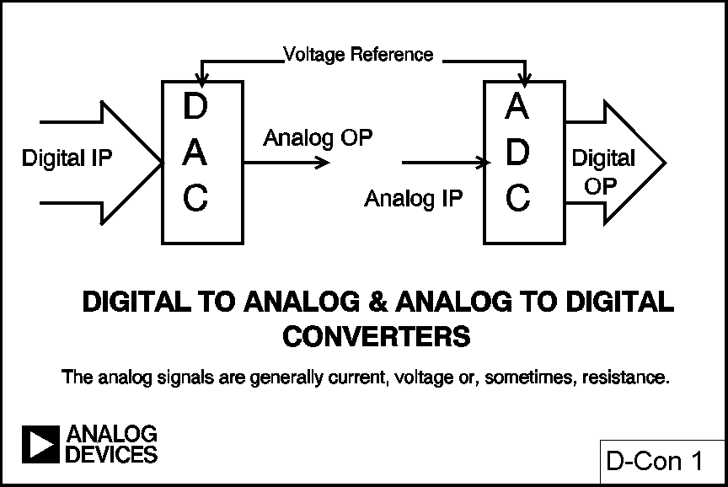
Converters
Notes:
The most important thing to remember about both DACs and ADCs is that one of the signals is digital, and therefore quantised. This is to say that an N-bit word represents one of 2^{N} possible states and therefore an N-bit DAC (with a fixed reference) can have only 2^{N} possible analog outputs, and an N-bit ADC can have only 2^{N} digital ones.
The analog signals will generally be voltages or currents, but may be resistance, and can be any analog quantity, not necessarily an electrical one. Such cases, where a transducer is integrated with a data converter, are less common, but certainly not unknown. The commonest are optical:- DACs with light output and ADCs with integral photocells.
The parameters of data converters may be expressed in several different ways: lsbs, parts per million of full scale (ppm FS), millivolts (mV), etc. Different devices (even from the same manufacturer) will be specified differently, so converter users must learn to translate between the different types of specification if they are to compare devices successfully.
Before we can consider the various architectures used in data converters it is necessary to consider the performance to be expected, and the specifications which are important. The next three sections of this note will consider the definitions of errors and specifications used for data converters, so that when we consider particular architectures we can understand their strengths and weaknesses.

Slide 3
The Size of an LSB
Notes:
DC ERRORS IN DATA CONVERTERS
The first applications of data converters were in measurement and control applications where the exact timing of the conversion was usually unimportant and the data rate was slow. In such applications the DC specifications of converters are important but timing and AC specifications are not. Today many, if not most, converters are used in "sampling" and "reconstruction" systems where AC specifications are critical (and DC ones may not be) - these will be considered in the next section.

Slide 4
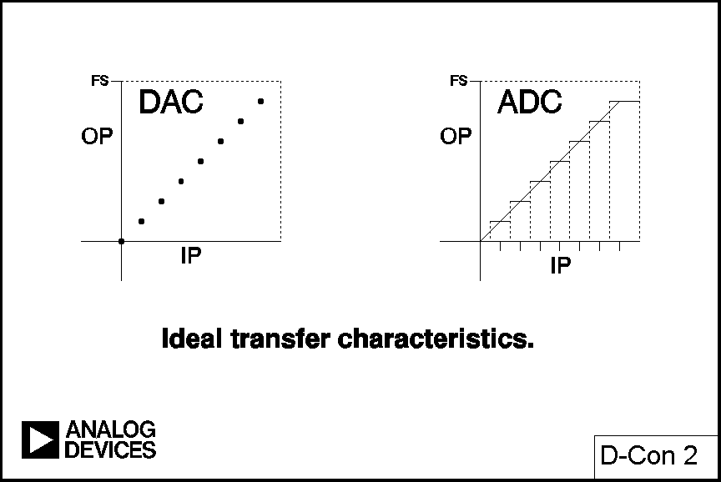
Ideal Transfer Characteristics
Notes:
Fig. 2 shows the ideal transfer characteristics for a 3-bit unipolar DAC and a 3-bit unipolar ADC. In the former case both the input and the output are quantised and the graph consists of eight points - while it is reasonable to discuss the line through these points it is very important to remember that the actual transfer characteristic is not a line but a number of discrete points.
The input to an ADC is analog and is not quantised, but its output is quantised, the transfer characteristic therefore consists of eight horizontal steps (when considering the offset, gain and linearity of an ADC we consider the line joining the midpoints of these steps).
In both cases digital full scale (all 1s) corresponds to 1 lsb below the analog full scale (the reference or some multiple thereof). This is because, as mentioned above, the digital code represents the normalised ratio of the analog signal to the reference and if this were unity the digital code would be all 0s and 1 in the bit above the msb.

Slide 5
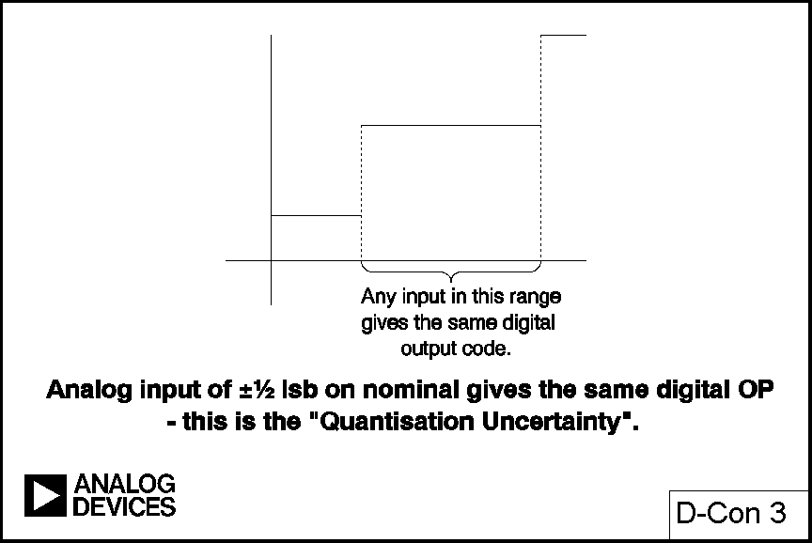
Quantization Uncertainty
Notes:
The (ideal) ADC transitions take place at ½ lsb above zero and thereafter every lsb until 1½ lsb below analog full scale. Since the analog input to an ADC can take any value but the digital output is quantised there may be a difference of up to ½ lsb between the actual analog input and the exact value of the digital output. This is known as the "quantisation error" or "quantisation uncertainty". In AC (sampling) applications this quantisation error gives rise to "quantisation noise" which will be discussed in the next section.
There are many possible digital coding schemes for data converters: binary, offset binary, 1's compliment, 2's compliment, gray code, BCD and others. This article, being devoted mainly to the analog issues surrounding data converters, will use simple binary and offset binary in its examples and will not consider the merits and disadvantages of these, or any other, forms of digital code.

Slide 6
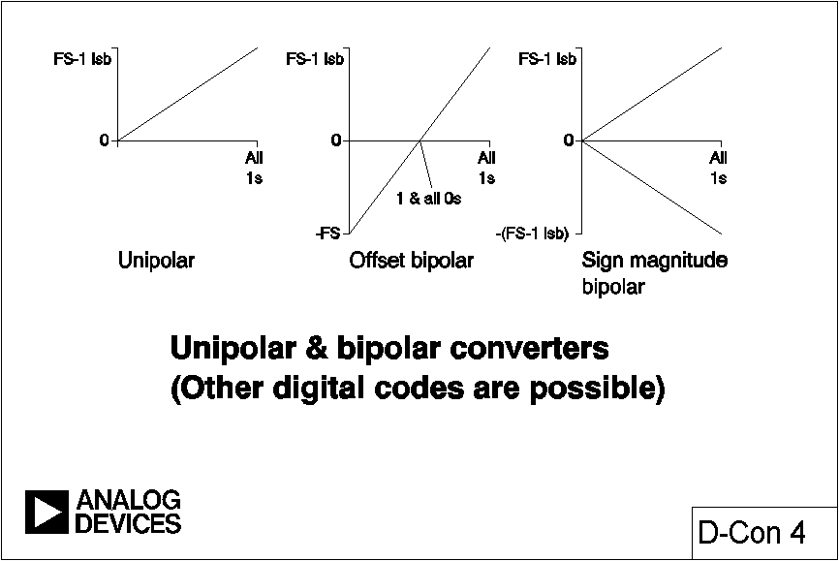
Unipolar & Bipolar Converters
Notes:
The examples in Fig. 2 use unipolar converters, whose analog port has only a single polarity. These are the simplest type, but bipolar converters are more generally useful. There are two types of bipolar converter: the simpler is merely a unipolar converter with an accurate 1 msb of negative offset (and many converters are arranged so that this offset may be switched in and out so that they can be used as either unipolar or bipolar converters at will), but the other, known as a "sign magnitude" converter is more complex and has N bits of magnitude information and an additional bit which corresponds to the sign of the analog signal. Sign magnitude DACs are quite rare, and sign magnitude ADCs are found mostly in digital voltmeters (DVMs).

Slide 7
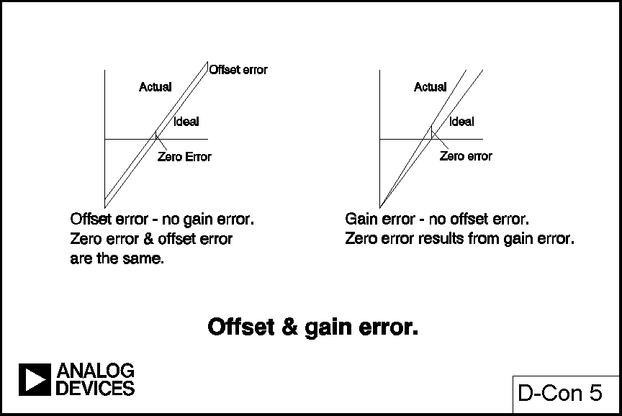
Offset & Gain Error
Notes:
The four DC errors in a data converter are offset errors, gain errors and two types of linearity errors. Offset and gain errors are analogous to offset and gain errors in amplifiers. (Though offset errors and zero errors, which are identical in amplifiers and unipolar data converters, are not identical in bipolar converters and should be carefully distinguished.) The transfer characteristics of both DACs and ADCs may be expressed as:-
D = K + GA
Where D is the digital code, A is the analog signal, and K and G are constants. In a unipolar converter K is zero and in an offset bipolar one it is -1 msb. The offset error is the amount by which the actual value of K differs from its ideal value. The gain error is the amount by which G differs from its ideal value (and is generally expressed as the percentage difference between the two, although it may be defined as the gain error contribution [in mV or lsb] to the total error at full scale). These errors may generally be trimmed by the data converter user. (Note, however, that although amplifier offset is trimmed at zero input and then the gain is trimmed near to full scale, the trim algorithm for a bipolar data converter may not be so straightforward.)

Slide 8
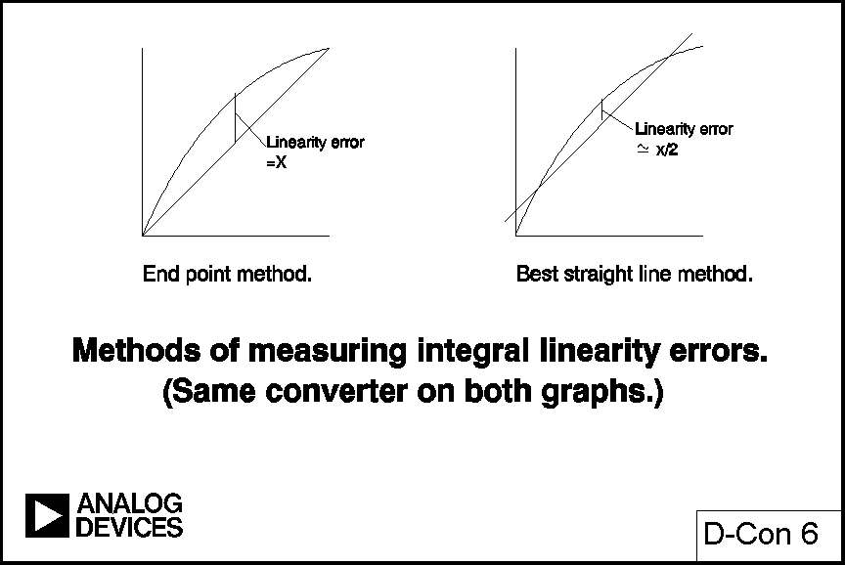
Linearity Error Measurement
Notes:
The integral linearity error of a converter is also analogous to the linearity error of an amplifier and is defined as the maximum deviation of the actual transfer characteristic of the converter from a straight line and is generally expressed as a percentage of full scale (but may be given in lsbs). There are two common ways of choosing the straight line:- end point and best straight line.
In the end point system the deviation is measured from the straight line through the origin and the full scale point (after gain adjustment). This is the most useful integral linearity measurement for measurement and control applications of data converters (since error budgets depend on deviation from the ideal transfer characteristic, not from some arbitrary "best fit") and is the one normally adopted by Analog Devices Inc.
The best straight line, however, does give a better prediction of distortion in AC applications, and also gives a lower value of "linearity error" on a data sheet. Here the best fit straight line is drawn through the transfer characteristic of the device using standard curve fitting techniques, and the maximum deviation is measured from this line. In general the integral linearity error measured in this way is only 50% of the value measured by end point methods. This makes the method good for producing impressive data sheets, but it is less useful for error budget analysis. For AC applications it is even better to specify distortion than DC linearity, so it is rarely necessary to use the best straight line method to define converter linearity. Analog Devices uses this definition on data sheets only in the case of second-source products where the original manufacturer's data sheet used best straight line, rather than end point, linearity.
The other type of converter non-linearity is "differential non-linearity" (DNL). This relates to the linearity of the code transitions of the converter. In the ideal case a change of 1 lsb in digital code corresponds to a change of exactly 1 lsb of analog signal (in a DAC a change of 1 lsb in digital code produces exactly 1 lsb change of analog output, while in an ADC there should be exactly 1 lsb change of analog input to move from one digital transition to the next).

Slide 9
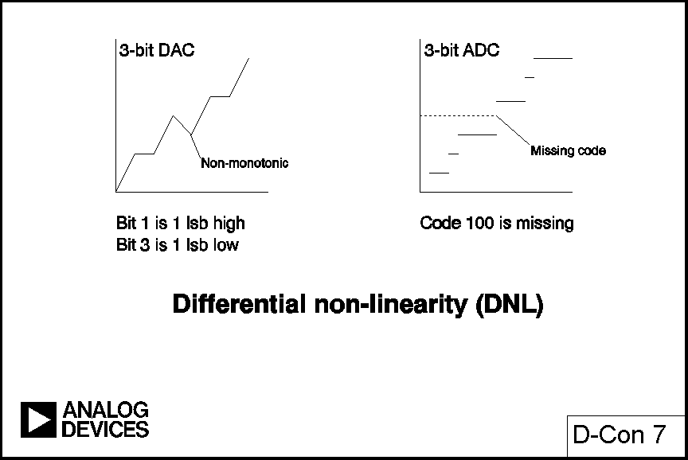
Differential Non-Linearity (DNL)
Notes:
Where the change in analog signal corresponding to 1 lsb digital change is more or less than 1 lsb there is said to be a DNL error. The DNL error of a converter is normally defined as the maximum value of DNL to be found at any transition.
If the DNL of a DAC is <-1 at any transition the DAC is "non-monotonic" (i.e. its transfer characteristic contains one or more maxima or minima). A DNL >+1 does not cause non-monotonicity, but is still undesirable. In many DAC applications (especially closed-loop systems where non-monotonicity can change negative feedback to positive feedback) it is critically important that DACs are monotonic and monotonicity is often explicitly specified on data sheets, although if the DNL is guaranteed to be less than 1 lsb (i.e. lsb) then the device must be monotonic, even without an explicit guarantee.
ADCs can be non-monotonic, but a commoner result of excess DNL in ADCs is missing codes. Missing codes (or non-monotonicity) in an ADC are as objectionable as non-monotonicity in a DAC and as much to be avoided. Again, they result from DNL<-1 lsb.

Slide 10
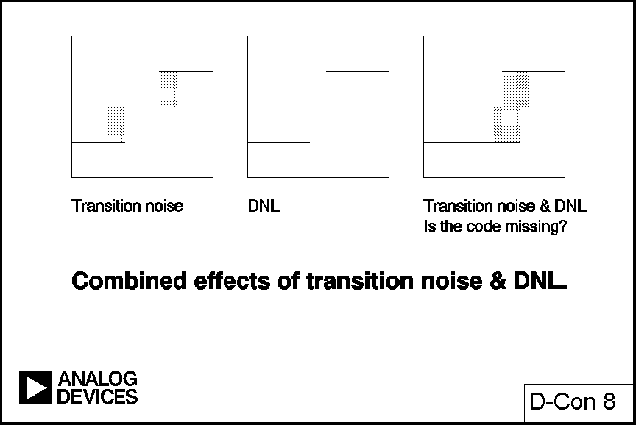
Combined Effects of Transition Noise & DNL
Notes:
Defining missing codes is more difficult than defining non-monotonicity. All ADCs suffer from some transition noise (think of the flicker between adjacent values of the last digit of a DVM). As resolutions become higher the range of input over which transition noise occurs may approach (or even exceed) 1 lsb. In such a case, especially if combined with a negative DNL error, it may be that there are some (or even all) codes where transition noise is present for the whole range of inputs. There are therefore some codes for which there is no input which will guarantee that code as an output, although there may be a range of inputs which will sometimes produce that code.
For lower resolution ADCs it may be reasonable to define "no missing codes" as a combination of transition noise and DNL which guarantees some level (perhaps 0.2 lsb) of noise-free code for all codes, but this is impossible to achieve at the very high resolutions achieved by modern Σ−Δ converters. In these cases the manufacturer must define noise levels and resolution in some other way. Which method is used is less important than that the data sheet should contain a clear definition of the method used and the performance to be expected.

Slide 11
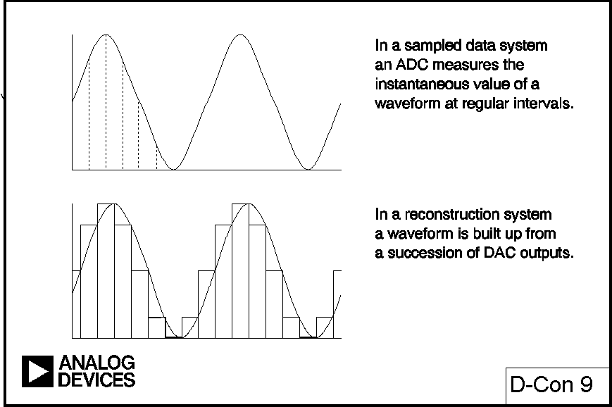
Sampled Data Systems
Notes:
AC ERRORS IN DATA CONVERTERS
Over the last decade the major application of data converters has shifted from DC measurement and control applications to AC sampling and reconstruction. Detailed descriptions and definitions of sampled data systems are beyond the scope of this note but they are thoroughly discussed in references [1] and [2]. In very simple terms a "sampled data system" is a system where the instantaneous value of an AC waveform is sampled at regular intervals. The resulting digital codes may be used to store the waveform (as in CDs and DATs) or intensive computation on the samples (Digital Signal Processing or DSP) may be used to perform filtering, compression and other operations. The inverse operation, "reconstruction", occurs when a series of digital codes are fed to a DAC to reconstruct an AC waveform - an obvious example of this is a CD or DAT player, but the technique is very widely used indeed in telecommunications, radio, synthesisers and many other applications.
The data converters used in these applications must have good performance with AC signals, but may not require good DC specifications. The first high performance converters to be designed for such applications were often manufactured with good AC specifications but poor, or unspecified, DC performance. Today the design tradeoffs are better understood and most converters will have good, and guaranteed, AC and DC specifications (although DACs for digital audio, which must be extremely competitive in price, are generally sold with comparatively poor DC specifications - not because their DC performance is poor, but because it is not tested during manufacture).
While it is easier to discuss the DC parameters of both DACs and ADCs together, their AC specifications are sufficiently different to deserve separate consideration.

Slide 12
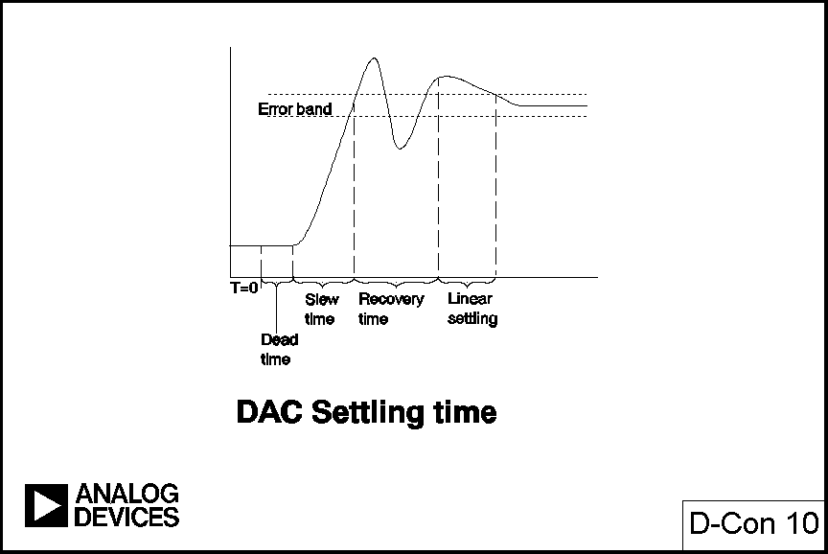
DAC Settling Time
Notes:
AC ERRORS IN DACS
The AC specifications which are most likely to be important with DACs are settling time, glitch, distortion and phase noise.
The settling time of a DAC is the time from a change of digital code to when the output comes within and remains within some error band. With amplifiers it is hard to make comparisons of settling time since their error bands may differ from amplifier to amplifier, but with DACs the error band will almost invariably be ±1 or ±½ lsb.
The settling time of a DAC is made up of four different periods:- the switching time or dead time, during which the digital switching, but not the output, is changing, the slewing time, during which the rate of change of output is limited by the slew rate of the DAC output, the recovery time, when the DAC is recovering from its fast slew (and may overshoot), and the linear settling time when the DAC output approaches its final value in an exponential or near-exponential manner. If the slew time is short compared to the other three (as is usually the case with current output DACs) then the settling time will be largely independent of the output step size, whereas if the slew time is a significant part of the total, then the larger the step the longer the settling time.

Slide 13
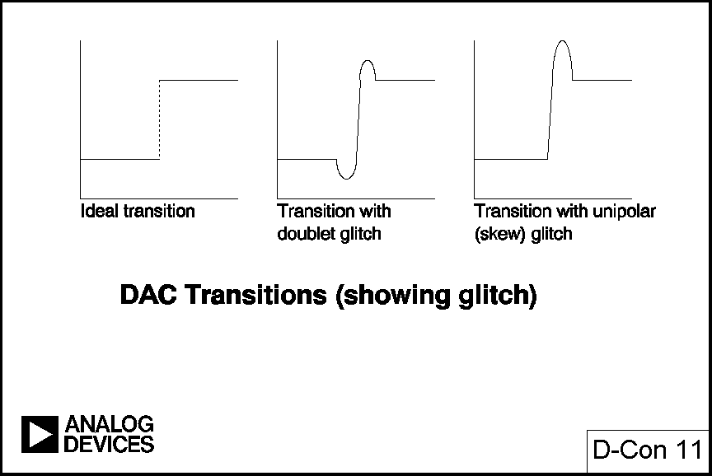
DAC Transitions
Notes:
Ideally when a DAC output changes it should move from one value to its new one monotonically. In practice the output is likely to overshoot or undershoot or both. This uncontrolled movement of the DAC output during a transition is known as glitch. It can arise from two mechanisms:- capacitive coupling of digital transitions to the analog output, and the effects of some switches in the DAC operating more quickly than others and producing temporary spurious outputs.
Capacitive coupling frequently produces roughly equal positive and negative spikes (sometimes called a "doublet" glitch) which more or less cancel in the longer term. These glitches occur whether or not a reference voltage is present on the DAC. The glitch produced by switch timing differences is generally unipolar, much larger, and does not occur in the absence of a reference (so the effects of capacitive coupling and switch timing may often be observed separately).
Glitch is generally defined in terms of "glitch energy". The term is a misnomer since the unit is Volt Seconds (or more probably µVSec or pVSec) and the magnitude of a glitch is better referred to as the "glitch impulse".

Slide 14
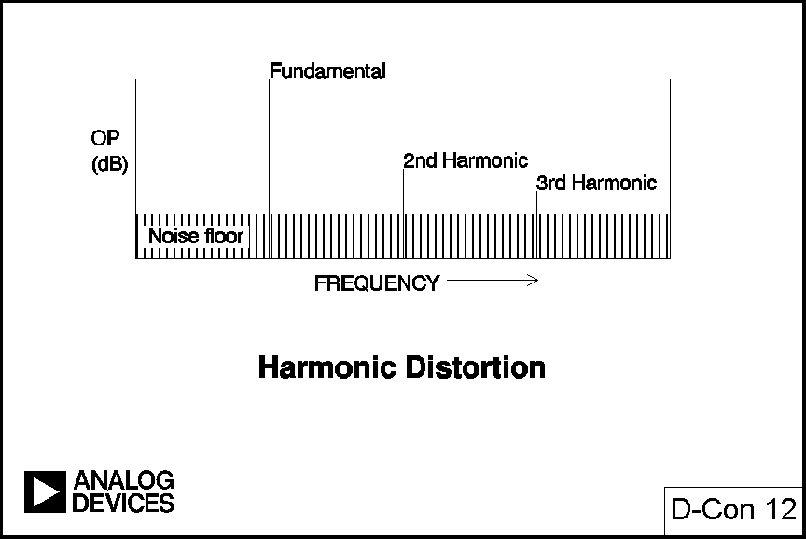
Harmonic Distortion
Notes:
If we consider the spectrum of a waveform reconstructed by a DAC from digital data we find that in addition to the expected spectrum (which will contain one or more frequencies, depending on the nature of the reconstructed waveform) there will also be noise and distortion products. Distortion may be specified in terms of harmonic distortion or intermodulation distortion or both. Harmonic distortion is defined as the ratio of harmonics to fundamental when a (theoretically) pure sine wave is reconstructed, and is the commonest specification. Since it can be hard to separate harmonics from noise it may be easier to measure the ratio of signal to (noise plus harmonics) or (noise plus distortion).

Slide 15
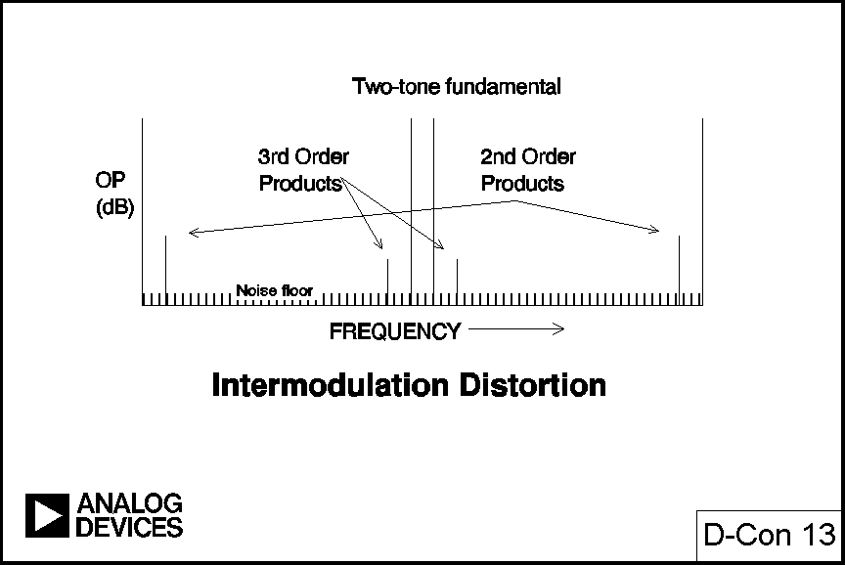
Intermodulation Distortion
Notes:
Intermodulation distortion is the result of non-linearities in a device (in this case a DAC) causing mixing. If we attempt to reconstruct two pure sine signals at F1 and F2 simultaneously and intermodulation occurs we shall see "second-order intermodulation products" at the frequencies and , and "third-order intermodulation products" at the frequencies and . If F1 and F2 are close together the second-order intermodulation products will be close to DC and to their second harmonics and relatively easily filtered, but the third-order products will be close to F1 and F2 and very hard to filter. (This is why third-order intermodulation products are often more of a problem than second-order ones.) When intermodulation occurs third-order intermodulation products increase in magnitude by 3 dB for each dB increase of the basic signal.

Slide 16
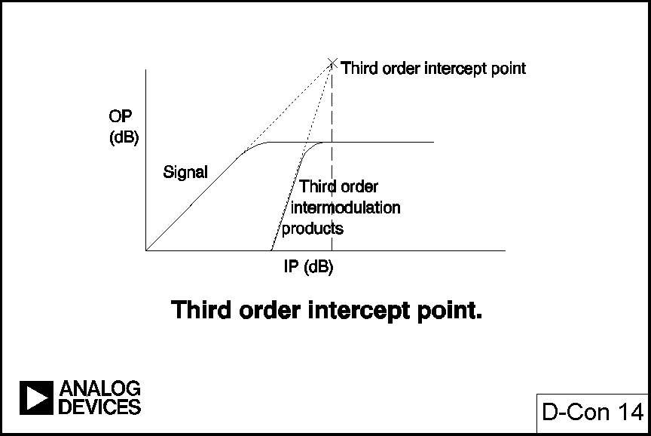
Third Order Intercept Point
Notes:
If we plot the amplitudes of (two-tone) input and output and (two-tone) input and third-order intermodulation product output on the same log-log (dB-dB) scale we obtain two lines: one with a gradient of unity and one with a gradient of 3. Both lines roll over (limit) before they intersect, but if we project them to their intersection the value of (two-tone) input at their intersection is the "third-order intercept" of the device and is used as a figure of merit (the higher the better).

Slide 17
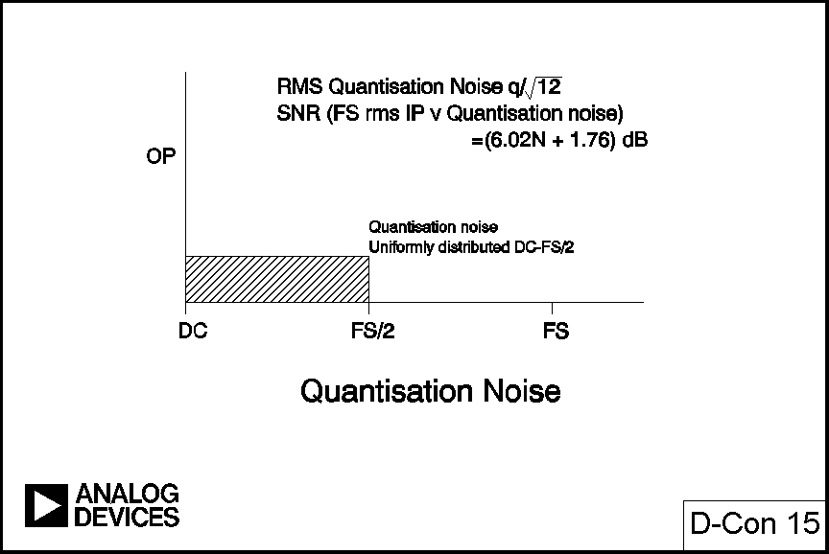
Quantization Noise
Notes:
AC ERRORS IN ADCS
The AC specifications of ADCs include harmonic and intermodulation distortion (which we have already discussed), full-power bandwidth, effective number of bits (ENOB), and sampling clock jitter. We must also consider quantisation noise.
When we discussed the DC performance of ADCs we pointed out that the input of an ADC is analog and therefore has infinite resolution, but the output is quantised into 2^{N} steps. The difference between analog input and the exact value of the digital output it produces is the quantisation error. The same phenomenon occurs in AC systems, producing broadband noise with uniform spectral density between DC and half the sampling frequency. This is known as quantisation noise.
The rms quantisation noise voltage of an ADC in the Nyquist band (DC - F_{S}/2) is where q is the value of the lsb. From this we can calculate that the SNR of a perfect N-bit ADC with a full scale sine wave input signal is limited to (6.02N + 1.76) dB by quantisation noise. Like the Johnson noise of a perfect resistor, quantisation noise is a fundamental and cannot be improved by changes in converter design. However, again like Johnson noise, we can redesign systems so that its effects are less damaging.
Quantisation noise may be fundamental, but most high resolution ADCs have noise or distortion sources that are larger than the quantisation noise, and which reduce their effective resolution to less than the number of bits given on their data sheets.

Slide 18
Large Signal Bandwidth
With small signals, the bandwidth of a circuit is limited by its overall frequency response.
At high levels of signal, the slew rate of some stage (generally the output stage) may control the upper frequency limit.
In amplifiers, there are so many variables that “Large Signal Bandwidth” needs to be redefined in every individual case and “slew rate” is a more useful parameter for a data sheet.
In ADCs, the maximum signal swing is the ADC’s full-scale span, and is therefore defined so “Full Power Bandwidth may appear on the datasheet.
HOWEVER, the “Full Power Bandwidth” specification says nothing about distortion levels. ENOB is much more useful in practical applications
(If “Full Power Bandwidth” is specified and ENOB is not, somebody is probably trying to hide something!)
Notes:
If we plot the gain of an amplifier with a small signal of a few millivolts or tens of millivolts we find that as we increase the input frequency there is a frequency at which the gain has dropped by 3 dB. This frequency is the upper limit of the "small signal bandwidth" of the amplifier and is set by the internal pole(s) in the amplifier response. If we drive the same amplifier with a large signal so that the output stage swings with its full rated peak to peak output voltage we may find that the upper 3 dB point is at a lower frequency, being limited by the slew rate of the amplifier output stage. This high level 3 dB point defines the "large signal bandwidth" of the amplifier. When defining the large signal bandwidth of an amplifier a number of variables must be considered, including the power supply, the output amplitude (if slew rate is the only limiting factor it is obvious that if the signal amplitude is halved the "large signal bandwidth" is doubled), and the load. Thus "large signal bandwidth" is a rather uncertain parameter in an amplifier, since it depends on so many uncontrolled variables - in cases where the large signal bandwidth is less than the small signal bandwidth it is better to define the output slew rate and calculate the maximum output swing at any particular frequency. In an ADC, however, the maximum swing is always full-scale, and the load seen by the signal is defined. It is therefore quite reasonable to define the large signal bandwidth of an ADC and report it on the data sheet.
However, the large signal bandwidth tells us the frequency at which the amplitude response of the ADC drops by 3 dB - it tells us nothing at all about the relationship between distortion and frequency. If we study the behaviour of an ADC as its input frequency is increased we discover that, in general, noise and distortion increase with frequency. This reduces the resolution that we can obtain from the ADC.

Slide 19
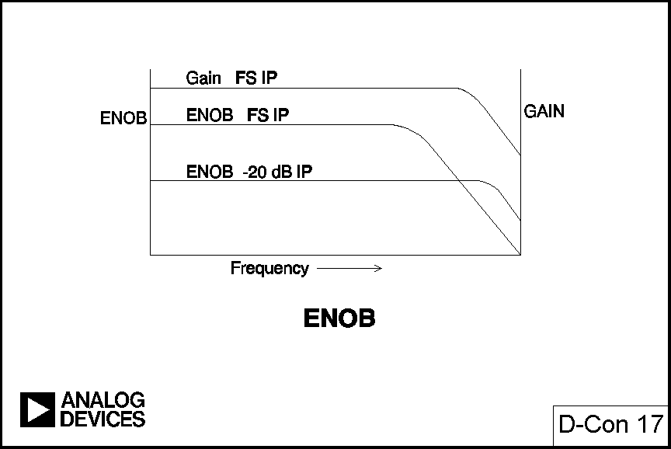
ENOB
Notes:
If we draw a graph of the ratio of signal to noise plus distortion of a converter against its input frequency we find a much more discouraging graph than that of its frequency response. The ratio of signal to noise plus distortion can be expressed in dB or as an effective number of bits (ENOB). As we have seen above, the SNR of a perfect N-bit ADC (with a full-scale sine input) is (6.02N + 1.76) dB. If we have an ADC with an SNR of X dB with a particular input then we can solve the equation
and determine the effective resolution of the converter with that input. A graph of ENOB against variations of input amplitude and frequency can be depressing when we see just how little of the DC resolution of the ADC can actually be used, but can sometimes show interesting features: the ADC in Fig 17, for instance, has a larger ENOB for signals at 10% of FS at 1 MHz than for FS signals of the same frequency - a simple frequency response curve cannot have plots crossing in this way.

Slide 20
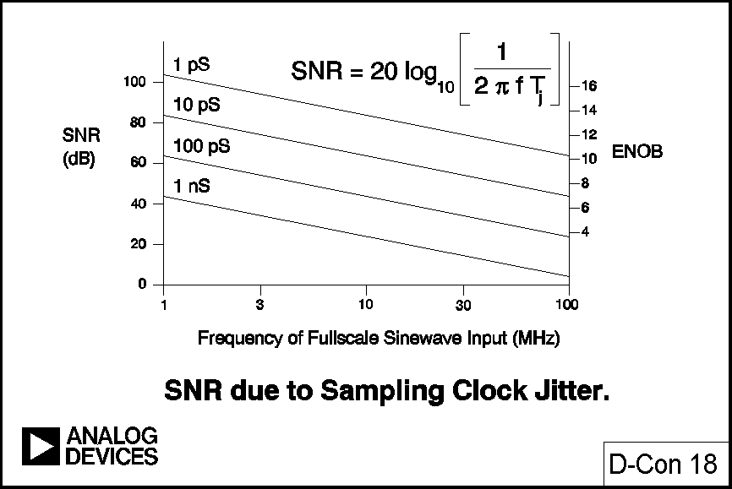
SNR Due to Sampling Clock Jitter
Notes:
One of the reasons that the SNR of an ADC rises with input frequency may be deduced from Fig 18, which shows the effects of phase jitter on the sampling clock of an ADC. They are quite serious, and show why, especially at higher input/output frequencies, extreme care must be taken to minimise phase noise in the sampling/reconstruction clock of any sampled data system. This care must extend to all aspects of the clock signal:- the oscillator itself (a 555 timer is absolutely inadequate, but even a quartz crystal oscillator can give problems if it uses an active device which shares a chip with noisy logic); the transmission path (these clocks are very vulnerable to interference of all sorts), and phase noise introduced in the ADC or DAC. The commonest source of phase noise in converter circuitry is aperture jitter in integral sample-and-hold (SHA) circuitry.
A decade or so ago sampling ADCs were built up from a separate SHA and ADC. Interface design was difficult and a key parameter was aperture jitter in the SHA. Today most sampled data systems use sampling ADCs which contain an integral SHA. The aperture jitter of the SHA may not be specified as such, but this is not a cause of concern if the SNR or ENOB is clearly specified, since a guarantee of a specific SNR is an implicit guarantee of an adequate aperture jitter specification.

Slide 21
Components for Data Converters
Data Converters require:
  Good logic
  Good switches
  Good analog circuitry (amplifiers, comparators and references)
  Good resistors
Notes:
COMPONENTS & PROCESSES FOR DATA CONVERTERS
Data converters may be constructed with a wide range of technologies, although the majority are monolithic integrated circuits (ICs) of various types. There are many IC technologies, and many tradeoffs between them. In general data converters require logic circuitry and switches, and some precision analog circuitry.
This precision analog circuitry may include stable, accurate voltage or current references, stable precision-matched resistors, and precision amplifiers and comparators. The processes used to manufacture good amplifiers, comparators and references do not, in general, make good logic, so manufacturers of early data converters used multi-chip hybrids to overcome these process limitations. Hybrid technology tends to be expensive, so converter manufacturers have been in the forefront of the development of IC processes capable of both analog and digital performance, so that data converters can be manufactured on a single chip. In general they have been successful, but even today some of the highest performance converters require chips from more than one process.

Slide 22
Hybrid Converters
Early Data Converters used hybrid technology to achieve performance unavailable from any single monolithic technology.
Even today, some of the best converters cannot use any available monolithic technology and are hybrid
“Compound Monolithic” is a marketer’s term for a simpler (and cheaper) hybrid technology where two monolithic chips from different technologies are mounted together in a single package, but without a ceramic substrate or other components.
Notes:
Since the name "hybrid" is perceived as implying "expensive" some of these converters have had their process renamed. Where two monolithic chips share a package to make a converter but do not require a ceramic substrate or any other integrated components, the structure, which is much less expensive than classical hybrid technology, is sometimes known as "compound monolithic" rather than "hybrid".

Slide 23
Monolithic Converter Processes
Bipolar processes have good analog performance but less good logic and switches.
CMOS processes make excellent logic and switches but relatively poor amplifiers and lousy references.
Processes combining the two (BIMOS , LCCMOS, etc.) tend to be more complex and expensive and have slightly less performance than the sum of the two but are very convenient.
Good designers choose the best process for the circuit to be designed.
Notes:
In general bipolar processes make good, stable, low-noise amplifiers, comparators and references. Bipolar logic, however, though fast, occupies large chip areas and is therefore expensive. Also, processes which make good bipolar logic tend to be noisier than analog processes. CMOS is capable of making high-density low-power logic very efficiently, but although it can also make good analog switches it is not very suitable for amplifiers and almost incapable of making references.
These considerations caused process technologists to combine bipolar and CMOS processes to achieve both low-power high density logic and high-accuracy low noise analog circuitry on a single chip. The resulting processes are more complex, and therefore more expensive, than simple bipolar and CMOS processes but do have better mixed performance. They include BIMOS processes which are basically bipolar processes to which CMOS structures have been added, and linear compatible CMOS (LC²MOS or LCCMOS) which is basically CMOS with added bipolar capability. However, the compromises necessary to combine features mean that neither BIMOS nor LCCMOS offers quite as good performance as its parent process does in its speciality. Thus BIMOS and LCCMOS have not replaced bipolar or CMOS technology, but designers now have four processes to choose from when designing a data converter.
Of course to suggest that there is only one of each of these process is a gross simplification, and omits all considerations of such process developments as complimentary bipolar (CB) and dielectrically isolated (DI) processes - since this note is concerned with converter structures, however, it is not really appropriate to discuss IC processes in detail. There is, however, one process technology which does deserve special mention, since it is crucial to the manufacture of any data converter requiring stable precision resistors. This is thin film resistor technology.

Slide 24
Thin Film Resistors
One of the key technologies for making many types of monolithic data converters is the ability to deposit accurate, stable SiCr resistors on monolithic chips.
Some converters use these resistors as fabricated; others require the additional accuracy and economy of laser trimming.
Parameters include matching to 0.005%, TC<20 ppm, Diff TC<0.2 ppm, and long term stability of the order of
1 ppm/1000 hours (drunkard’s walk).
Notes:
Analog Devices has spent many man-years of effort to develop the ability to deposit stable thin-film resistors on integrated circuit chips, and yet more man-years in learning to laser trim them. All the processes mentioned above can incorporate such resistors. They have stability of <20 ppm/°C and matching to within 0.005%. (The resistors can be made to match to within 0.01% or better without laser trimming, but to achieve this they must be very large - in practice if resistors must match to better than 0.1 or 0.05% it is more economical to laser trim them than to design them to meet the specification without trimming.) Most of the resistors in the next sections are these laser-trimmed SiCr thin film resistors.

Slide 25
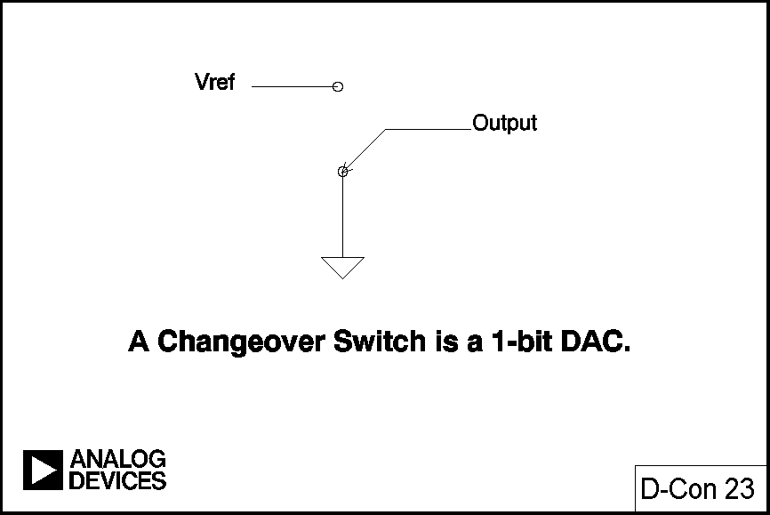
Changeover Switches
Notes:
DAC STRUCTURES
It is reasonable to consider a changeover switch, switching an output between a reference and ground or between equal positive and negative reference voltages as a 1-bit DAC. Such a simple device is a component of many more complex DAC structures, and is used, with oversampling, as the basic analog component in the Σ−Δ DAC we shall discuss later. Nevertheless it is a little too simple to require discussion and it is more rewarding to consider more complex structures.
The DACs most commonly used as examples of simple DAC structures are binary weighted DACs or ladder networks, but these, though simple in structure, require quite complex analysis. The simplest structure of all, after the changeover switch mentioned above, is the Kelvin divider. An N-bit version of this DAC simply consists of 2^{N} equal resistors in series. The output is taken from the appropriate tap by closing one of the 2^{N} switches (there is some slight digital complexity involved in decoding to 1 of 2^{N} switches from N-bit data, but digital circuitry is comparatively cheap).

Slide 26
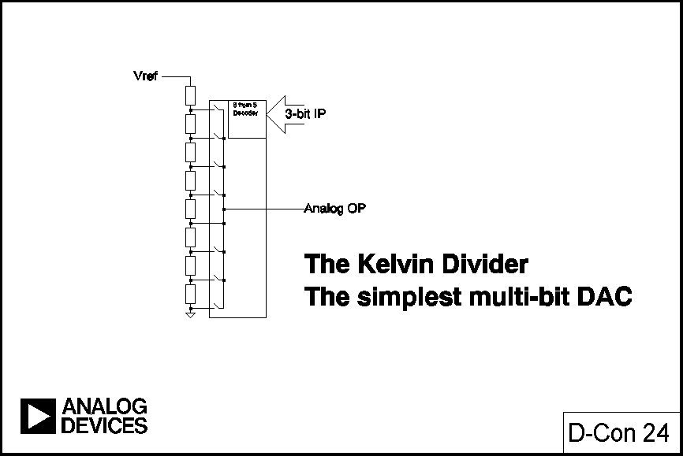
Kelvin Dividers
Notes:
This architecture is simple, has a voltage output (but a code varying Z_{OUT}) and is inherently monotonic (even if a resistor is zero OP_{N} cannot exceed OP_{N+1}). It is linear if all the resistors are equal, but may be made deliberately non-linear if a non-linear DAC is required. Since only two switches operate during a transition it is a low-glitch architecture. Its major drawback is the large number of resistors required for high resolution, and as a result it is not commonly used (the only commercially available DAC of this type is a fast, low-glitch 8-bit device from Philips) - but, as we shall see later, it is used as a component in more complex DAC structures.
There is an analogous current output DAC which consists, again, of 2^{N} resistors (or current sources), but in this case they are all connected in parallel between the reference voltage input and the virtual ground output.

Slide 27
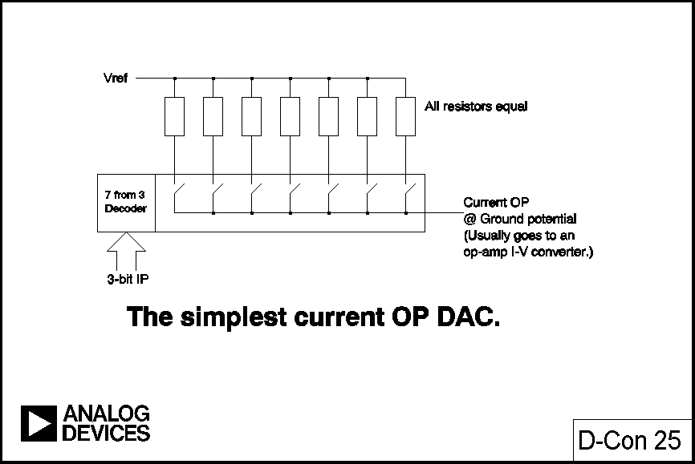
Simplest Current OP DAC
Notes:
In this DAC once a resistor is switched into circuit by increasing digital code any further increases do not switch it out again. The structure is thus inherently monotonic, irrespective of inaccuracies in the resistors, and like the previous case, may be made intentionally non-linear where a specific non-linearity is required. Again like the previous case the architecture is rarely, if ever, used to fabricate a complete DAC, because of the large numbers of resistors and switches required, but is often used as a component in a more complex DAC structure.
Unlike the Kelvin divider this type of DAC does not have a unique name, although both types are referred to as "fully decoded DACs" or "thermometer DACs".

Slide 28
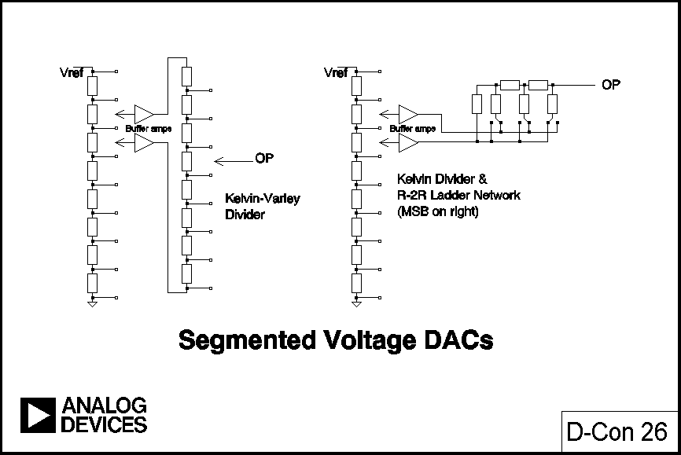
Segmented Voltage DACs
Notes:
Fully-decoded DACs are often used as components of more complex DACs. The commonest are "segmented DACs" where part of the output of a fully decoded DAC is further subdivided. The structure is used because the fully decoded DAC is inherently monotonic, so if the subdivision is also monotonic the whole resulting DAC is also monotonic.
A voltage segment DAC works works by further sub-dividing the voltage across one resistor of a Kelvin divider. The sub-division may be done with a further Kelvin divider (in which case the whole structure is sometimes known as a "Kelvin-Varley divider", or with some other DAC structure, and commercial 16-bit DACs exist with both arrangements:- the AD569 uses two cascaded 8-bit Kelvin dividers in a Kelvin-Varley structure, a total of 512 resistors, to give a 16-bit monotonic but only 13-bit linear DAC (trimming 512 resistors to achieve 16-bit linearity would be a very expensive operation, and in any case a chip with 512 trimmable resistors would be much too large to be economic, since trimmable resistors are much larger than non-trimmable ones); and the AD7846 uses a 12-bit ladder network in the voltage mode (qv) connected across one resistor of a 4-bit Kelvin divider.

Slide 29
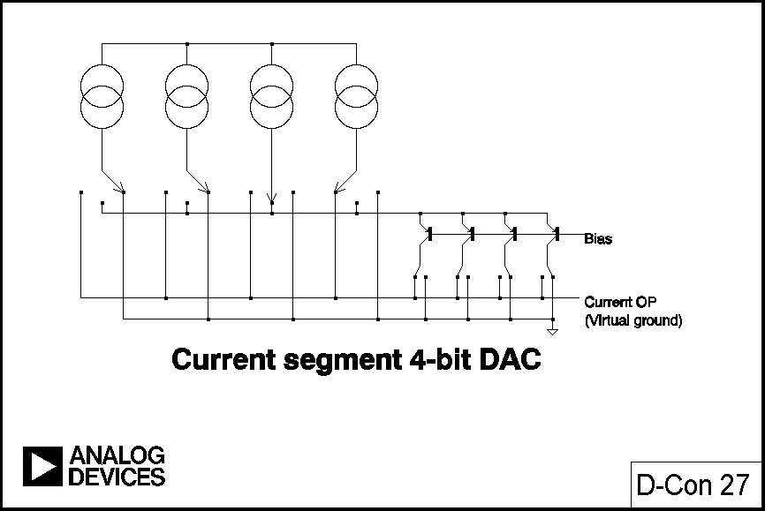
Current Segment 4-Bit DAC
Notes:
In a true current-segmented DAC using fully-decoded MSBs each current source has a three-way switch and is switched off, or to a further current steering DAC, or directly to the output. This architecture is inherently monotonic.

Slide 30
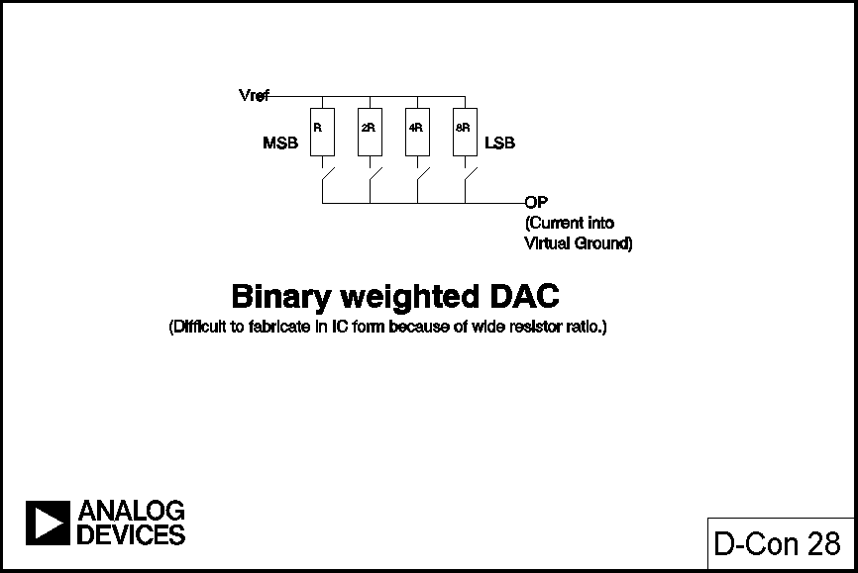
Binary Weighted DAC
Notes:
The simplest textbook example of a DAC, the binary-weighted DAC, is not inherently monotonic and is very hard to manufacture successfully. An N-bit DAC of this type consists of N resistors in the ratio 1:2:4:8:....:2^{N-1}. The lsb switches the 2^{N-1} resistor, the msb the 1 resistor, etc. The theory is simple but the practical problems of manufacturing an IC of an economical size with resistor ratios of even 128:1 for an 8-bit DAC are enormous, especially as the resistors must have matched temperature coefficients.
If the msb resistor is even a little high in value the msb current will be less than the sum of all the other bit currents and the DAC will not be monotonic (the differential non-linearity of most types of DAC is worst at major bit transitions). This architecture is never used in integrated circuit DACs, although, again, it has been used as a component of a more complex structure

Slide 31
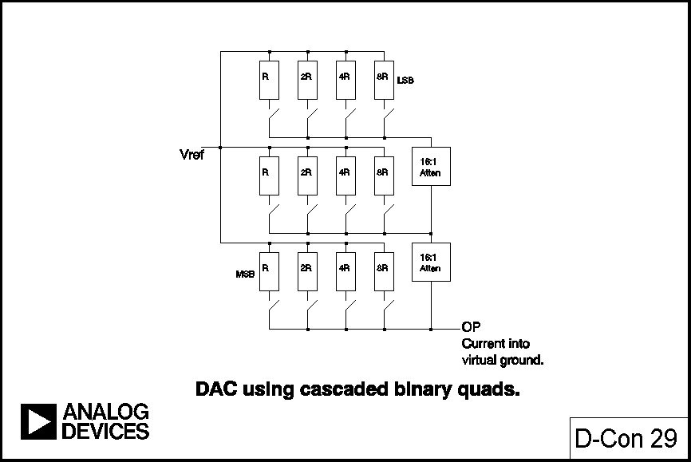
DAC Using Cascaded Binary Quads
Notes:
Fig. 29 shows a 12-bit DAC made from three 4-bit binary weighted DACs with attenuators. In the early days of IC DACs this architecture was sometimes used, but it was less than ideal, requiring 15:1 resistor ratios, which are still too high for comfort. The ideal resistor ratio for precision is as close as possible to 1:1, and the R:2R ladder network is not too far from this.

Slide 32
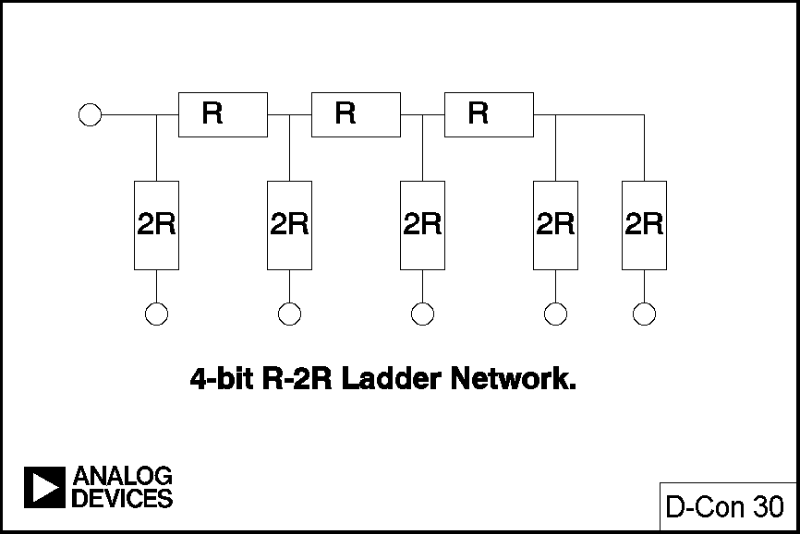
4-Bit R-2R Ladder Network
Notes:
The R:2R ladder is shown in Fig. 30 and uses resistors of only two different values: their ratio is 2:1. An N-bit DAC requires 2^{N}-1 resistors. There are two ways in which the R:2R ladder network may be used as a DAC, known respectively as the voltage mode and the current mode (they are sometimes called "normal" mode and "inverted" mode, but as there is no concensus on whether voltage mode or current mode is the "normal" mode for a ladder network this nomenclature can be misleading). Each has its advantages and disadvantages.

Slide 33
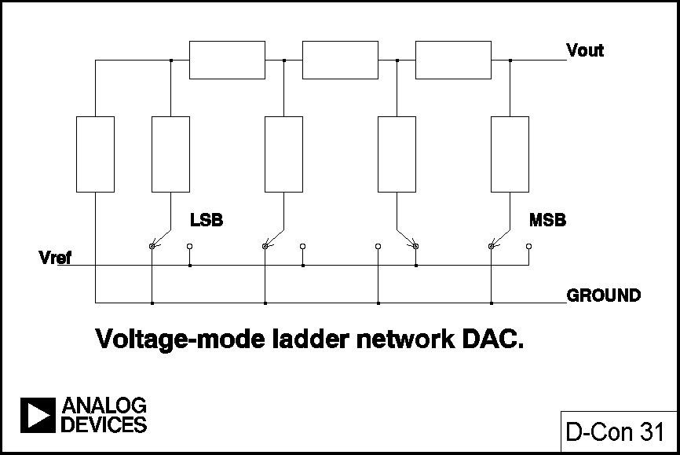
Voltage-Mode Ladder Network DAC
Notes:
In the voltage mode the "rungs" or arms of the ladder are switched between V_{ref} and ground and the output is taken from the end of the ladder. The output may be taken as a voltage, but the output impedance is independent of code so it may equally well be taken as a current into a virtual ground.
The voltage output is an advantage of this mode, as is the constant output impedance, which eases the neutralising of any amplifier on the output node. Additionally, the switches switch the arms of the ladder between a low impedance V_{ref} connection and ground so capacitive glitch currents tend not to flow in the load. On the other hand, the switches must operate over a wide voltage range (V_{ref} to ground), which is difficult from a design and manufacturing viewpoint, and the reference input impedance varies widely with code, so that the reference input must be driven from a very low impedance, and the gain of the DAC cannot be adjusted with a preset resistor in series with the V_{ref} terminal.

Slide 34
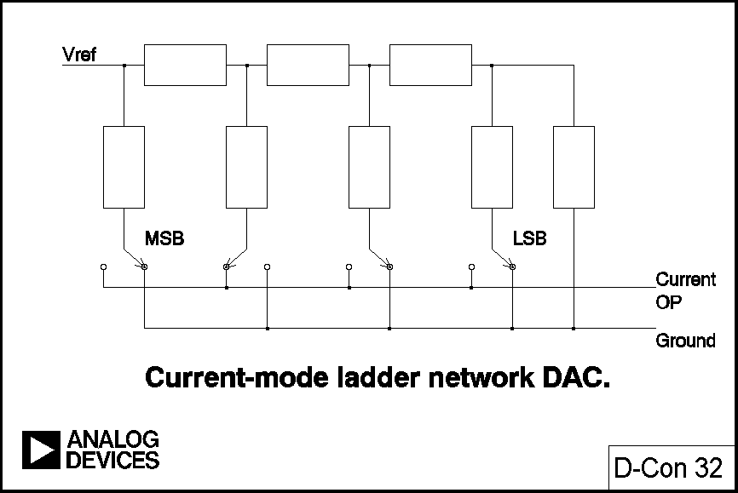
Current-Mode Ladder Network DAC
Notes:
The gain of a DAC in the current mode configuration may be adjusted with a series resistor since in the current mode the end of the ladder, with its code-independent impedance, is used as the V_{ref} terminal, and the ends of the arms are switched between ground and an output line which must be held at ground potential. The normal connection of a current mode ladder network output is to an op-amp configured as an I-V converter, but stabilisation of this op-amp is complicated by the DAC output impedance variation with code.
Current mode operation has higher glitch, though, since the switches connect directly to the output line, but as the switches of a current-mode ladder network are always at ground potential their design is less demanding and, in particular, their voltage rating does not affect the reference voltage rating. If switches capable of carrying current in either direction (such as MOS devices) are used, the reference voltage may have either polarity, or may even be AC. Such a structure is one of the commonest types of multiplying DAC (MDAC).

Slide 35
Multiplying DACs (MDACs)
In all DACs, the output is the product of the reference voltage and the digital code.
Most DACs work only over a limited range of reference voltages
DACs which work with reference voltages which include zero volts are known as multiplying DACs
Many MDACs work with bipolar and AC references
DACs which work with a large range of reference voltages, but not down to zero, are not true MDACs but are sometimes called MDACs. It is better to use the term “semi-multiplying DACs.”
Notes:
In all DACs the output is the product of the reference voltage and the digital code, so in that sense all DACs are multiplying DACs, but many DACs operate well only over a limited range of V_{ref}. True MDACs, however, are designed to operate over a wide range of V_{ref}. A strict definition of a multiplying DAC demands that its reference voltage range includes 0 V, and many, especially current mode ladder networks with CMOS switches, permit positive, negative and AC V_{ref}. DACs which do not work down to 0 V V_{ref} are still useful, however, and types where V_{ref} can vary by 10:1 or so are often called MDACs, although a more accurate description might be "semi-multiplying" DACs.
The ladder network is certainly the commonest DAC architecture. Where higher resolutions are required, however, trimming a ladder network can be demanding. A common way of minimising the problem is to build a current mode DAC with 2 or 3 fully decoded msbs and a ladder network for the remainder of the structure.

Slide 36
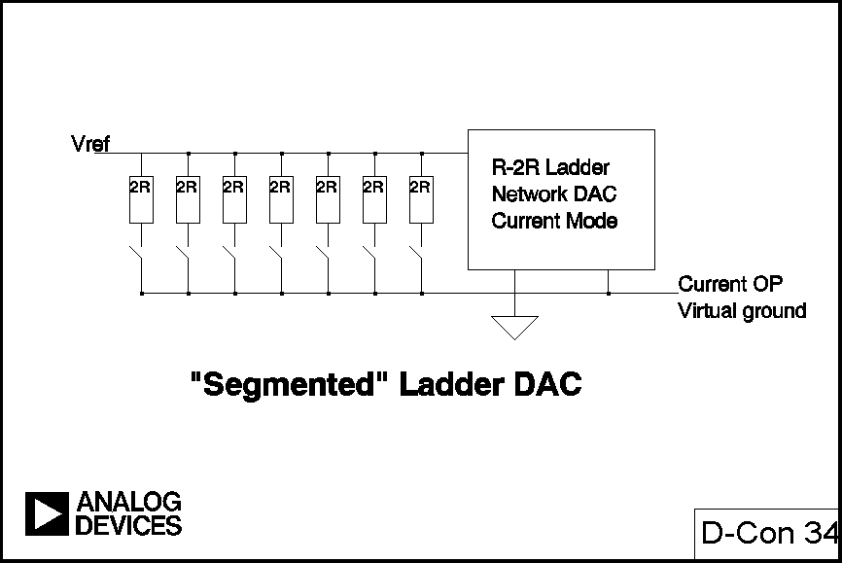
“Segmented Ladder” DAC
Notes:
This arrangement is sometimes referred to as a segmented DAC, but the description is not strictly accurate, as even if the ladder network is monotonic it is not inherently certain that the overall DAC will be, although it is comparatively easy to laser trim such an arrangement to monotonicity.

Slide 37
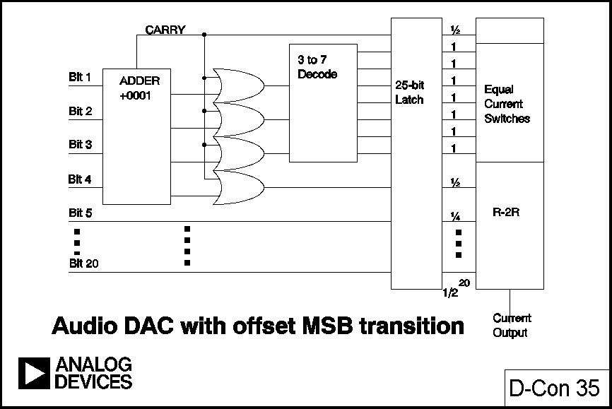
Audio DAC with Offset MSB Transition
Notes:
Digital audio requires DACs with resolutions of over 16-bits, good linearity and low cost. One way to make them is to use a ladder with several decoded msbs as described above, but this is likely to have comparatively large DNL at the msb transition, which is just where low DNL is needed for low audio distortion. This problem can be avoided by using a digital adder to put a digital offset in the DAC code, so that the msb transition of the input code is well offset from the mid-point of the DAC transfer characteristic, and then using an analog offset on the DAC output to restore the DC level at the crossover.
Another way of obtaining high resolution is to use oversampling and a 1-bit DAC. The technique, known as Σ−Δ, is computation intensive, so has only recently become practicable for the manufacture of high resolution DACs, but since it uses a 1-bit DAC it is intrinsically linear and monotonic.

Slide 38
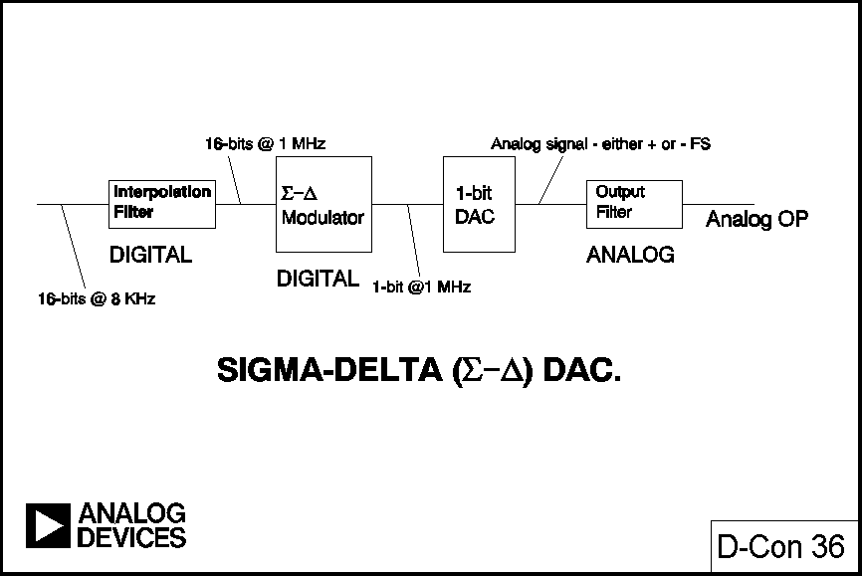
Sigma-Delta DAC
Notes:
A Σ−Δ DAC, unlike the Σ−Δ ADC we shall discuss later, is entirely digital. It consists of an "interpolation filter", a digital circuit which accepts data at a low rate, inserts zeros at a high rate, and then applies a digital filter algorithm and outputs data at high rate, a Σ−Δ modulator, which effectively acts as a low pass filter (LPF) to the signal but as a high pass filter (HPF) to the quantisation noise, and converts the resulting data to a high speed bit stream, and a 1-bit DAC (which, as we mentioned earlier, is simply a changeover switch) connected to equal positive and negative reference voltages. The output is filtered in an external analog LPF.
In theory a Σ−Δ DAC is perfectly linear and has very low noise. In practice they are very good, but, because of the difficulty of having an adequately fast clock with low enough phase noise and still separating digital noise from the analog signal, are still (as of late 1992) marginally less good for the highest quality digital audio than the best traditional DACs. Nevertheless Σ−Δ DACs are the optimum choice for a large number of low price, medium to high quality reconstruction DAC applications.

Slide 39
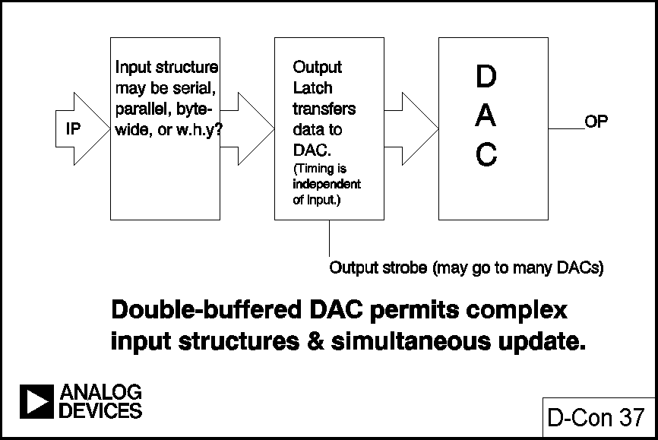
Double-Buffered DAC
Notes:
DAC LOGIC
The earliest monolithic DACs contained little, if any, logic circuitry and parallel data had to be maintained on the digital input to maintain the digital output. Today almost all DACs are latched and data need only be written once, not maintained.
There are innumerable variations of DAC input structure, which will not be discussed here, but the majority today are "double-buffered". A double-buffered DAC has two sets of latches. Data is initially latched in the first rank and subsequently transferred to the second. There are two reasons why this arrangement is useful.
The first is that it allows data to enter the DAC in many different ways. A DAC without a latch, or with a single latch, must be loaded with all bits at once, in parallel, since otherwise its output during loading may be totally different from what it was or what it is to become. A double-buffered DAC, on the other hand, may be loaded with parallel data, or with serial data, or with 4-bit or 8-bit words, or whatever, and the output will be unaffected until the new data is completely loaded and the DAC receives its update instruction.
The other convenience of the double-buffered structure is that many DACs may be updated simultaneously: data is loaded into the first rank of each DAC in turn, and when all is ready the output buffers of all DACs are updated at once. There are many DAC applications where the output of several DACs must change simultaneously, and the double-buffered structure allows this to be done very easily.

Slide 40
Serial DACs
If data is loaded serially into a DAC, it requires fewer data pins.
This saves space and also reduces capacitive noise coupling from data lines to the analog output .
If the shift register of a serial DAC has an output pin, a number of DACs may be connected in series (“daisy-chained”) to a single serial data port
Notes:
Most early monolithic high resolution DACs had parallel or byte-wide data ports and tended to be connected to parallel data buses and address decoders and addressed by microprocessors as if they were very small write-only memories (some DACs are not write-only, but can have their contents read as well - this is convenient for some applications but is not very common). A DAC connected to a data bus is vulnerable to capacitive coupling of logic noise from the bus to the analog output, and many DACs today have serial data structures. These are less vulnerable to such noise (since fewer noisy pins are involved), use fewer pins and therefore take less space, and are frequently more convenient for use with modern micro-processors, many of which have serial data ports. Some, but not all, of such serial DACs have data outputs as well as data inputs so that several DACs may be connected in series and data clocked to them all from a single serial port. The arrangement is often referred to as "daisy-chaining".

Slide 41
Types of Analog-to-Digital Converters
Comparator: 1-bit ADC
Flash: Fast, low-resolution, power-hungry
Magamp: A new architecture with lower power and complexity but speed approaching that of a flash ADC
Subranging: Quite fast, high-resolution, complex
Integrating: Slow, accurate, low-power
VFC: High-resolution, low-power, ideal for
telemetry
Tracking: Fast and slow, high-resolution
Successive Approximation: Versatile, general purpose
Sigma Delta: Complex, low-power, very accurate
Notes:
ADC STRUCTURES
In this section we shall consider the structures and conversion algorithms of eight types of ADC, but, as in the DAC section, we shall not be concerned with many details of their digital interfaces, save to point out that if logic is cheap the results of an A-D conversion may easily be reformatted in any convenient way; parallel, serial or byte-wide. This means that it is generally possible to find a general purpose ADC with integral logic to provide an output data format well-suited to any particular application. Special purpose ADCs (high speed, high resolution, etc.) may only be available with a more limited range of options.

Slide 42
Beware of ADC Logic Pitfalls!
After power-up, one or two conversions may be necessary before the ADC runs right. EOC cannot always be trusted at this time. An ADC may not behave the same way every time it starts.
EOC says conversion is finished. DRDY says that data is valid. There may be tens of nS difference between the two.
CS may not just enable the data--it may reset things for the next conversion. In some converters, you can’t not read the data. In some converters you can’t read the data twice. In some converters, you can’t strap CS and forget it.
FIND OUT WHAT SORT YOU’RE USING.
ALWAYS READ THE DATASHEET, OR ELSE...
Notes:
There are one or two practical points which are worth remembering about the logic of ADCs. On power-up many ADCs do not have logic reset circuitry and may enter an anomalous logical state. One or two conversions may be necessary to restore their logic to proper operation so (a) the first and second conversions after power-up should never be trusted, and (b) control outputs (EOC, DRDY, etc.) may behave in unexpected ways at this time (and not necessarily in the same way at each power-up) and care should be taken to ensure that such anomalous behaviour cannot cause system latch-up. (For example, EOC (EndOfConversion) should not be used to initiate conversion if there is any possibility that EOC will not occur until the first conversion has taken place, as otherwise initiation will never occur.)
Another detail which can cause trouble is the difference between EOC and DRDY (DataReady). EOC indicates that conversion has finished, DRDY that data is available at the output. In some ADCs data is not valid until several tens of nSec after the EOC has become valid, and if EOC is used as a data strobe the results will be unreliable.
As a final example some ADCs use CS (ChipSelect) edges to reset internal logic, and it may not be possible to perform another conversion without exercising CS (or it may not be possible to read the same data twice, or both).
For more detail it is important to read the whole of an ADC data sheet before using a part since there are innumerable small logic variations from type to type. Unfortunately many data sheets, even from Analog Devices, are not as clear as one might wish so it is also important to understand the general principles of ADCs in order to interpret data sheets correctly. That is one of the purposes of this article.

Slide 43
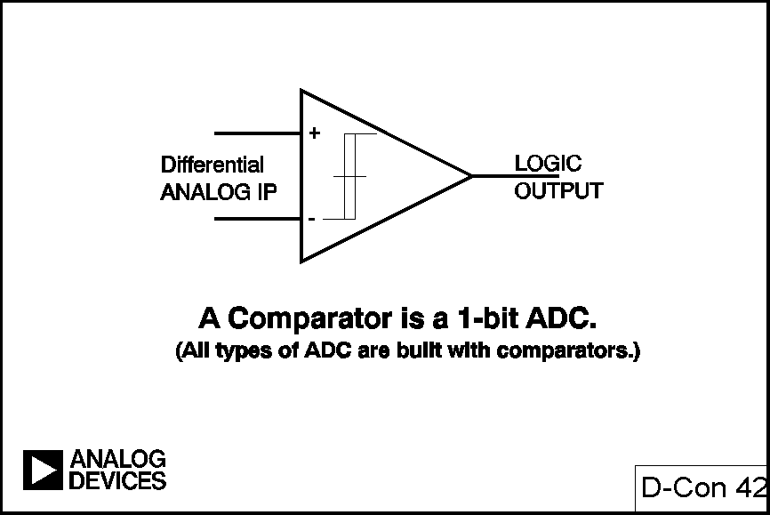
Comparators
Notes:
As a changeover switch is a 1-bit DAC, so a comparator is a 1-bit ADC. If the input is above a threshold the output has one logic value, below it has another. Moreover there is no ADC architecture which does not use at least one comparator of some sort.
The commonest comparator has some resemblance to an operational amplifier in that it uses a "long-tailed pair" of transistors or FETs as its input stage, but unlike an op-amp it does not use external feedback and its output is a logic level indicating which of the two inputs is at the higher potential. Some comparators have a millivolt or two of hysteresis to encourage "snap" action and to prevent local feedback from causing instability in the transition region.
It is not usual to use a discrete comparator as an element in a more complex ADC so this paper will not discuss the structure or use of comparators in detail (but more information may be found in references [1] and [3]). Where comparators are incorporated into IC ADCs their design must consider resolution, speed, power dissipation, offset voltage, bias current and the chip area occupied by the architecture which is chosen.

Slide 44
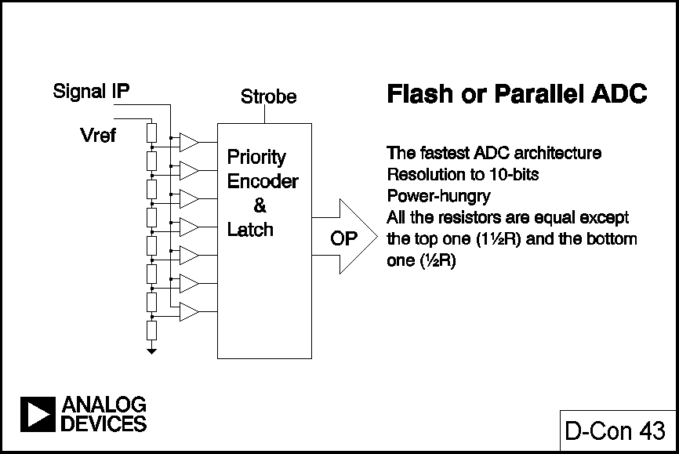
Flash or Parallel ADCs
Notes:
Flash ADCs (sometimes called parallel ADCs) are the fastest type of ADC and use large numbers of comparators. An N-bit flash ADC consists of 2^{N} resistors and 2^{N}-1 comparators arranged as in Fig. 43. It is clear that each comparator has a reference voltage which is 1 lsb higher than that of the one below it in the chain, and that for a given input voltage all the comparators below a certain point will have their input larger than their reference and one logic output, and all the comparators above that point will have reference larger than input and the other logic output. The 2^{N}-1 comparator outputs therefore behave in a way analogous to a mercury thermometer and the output code at this point is sometimes called a thermometer code. Since 2^{N}-1 data outputs are not really practical they are processed by a priority encoder to an N-bit output.
The signal is applied to all the comparators at once, so the thermometer output is delayed by only one comparator delay from the input, and the encoder N-bit output by only a few gate delays on top of that, so the process is very fast. However, the system uses large numbers of resistors and comparators for quite low resolutions, and if it is to be fast each comparator must run at relatively high power levels. Hence the problems of flash ADCs include limited resolution, high power dissipation and quite large (and therefore expensive) chip sizes. In addition the resistance of the reference resistor chain must be kept low to supply adequate bias current to the fast comparators, so the voltage reference has to source quite large currents (>10 mA).
In practice flash converters are available up to 10-bits (12 bit flash converters have been made, but are not commercially viable), but more commonly they have 8-bits of resolution. Their maximum sampling rate can be as high as 500 MSPS, and input full-power bandwidths in excess of 300 MHz are not uncommon.

Slide 45
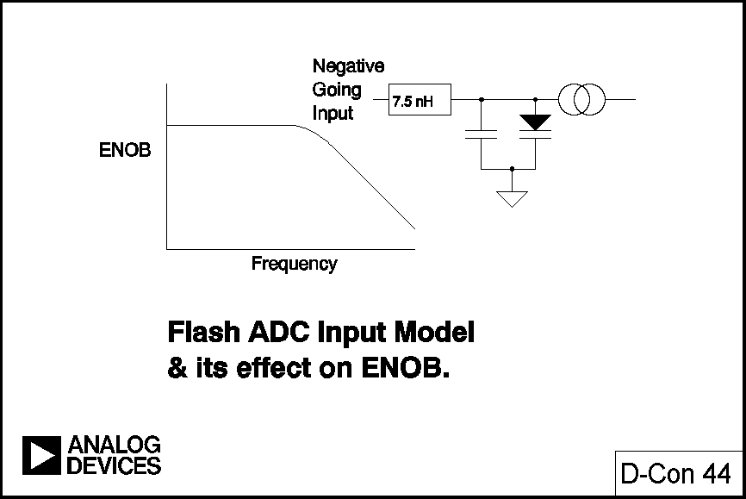
Flash ADC Input Model and Its Effect on ENOB
Notes:
But as we mentioned earlier, full-power bandwidths are not necessarily full-resolution bandwidths. The input to a flash ADC is applied in parallel to a large number of comparators. Each has a voltage variable junction capacitance, and we must also consider the inductance of the long conductor tracks on the chip from the pad to the comparators. The combination of inductance and non-linear capacitance results in all flash ADCs having reduced ENOB at high input frequencies, the exact amount of degradation will vary from type to type, but the basic problem is inherent in the architecture.
Although it is not practicable to make flash ADCs with high resolution, flash ADCs are used as subsystems in "subranging" ADCs (sometimes known as "half-flash ADCs"), which are capable of much higher resolutions (up to 16-bits).

Slide 46
Mag Amps 1

Slide 47
Mag Amps 1b
Notes:
Consider a full-wave rectifier. It has the transfer characteristic shown in Fig. 1.

Slide 48
Mag Amps 2
Notes:
If we amplify this output X2, and sum it with a –FS voltage, the overall transfer characteristic goes from +FS to –FS and back as the input goes from –FS to +FS – as we see in Fig. 2. If we apply this voltage to a comparator with its other input grounded we get the comparator output shown as well. This arrangement of full-wave rectifier, X2 gain, -FS sum and comparator is known as a “magamp”. Let us consider the result of cascading several magamps.

Slide 49
Mag Amps 3

Slide 50
Mag Amps 4

Slide 51
Mag Amps 5

Slide 52
Mag Amps 6

Slide 53
Mag Amps 7
Notes:
The simple ADC in Fig. 4 has data skew – i.e. the MSB data appears before the LSB, due to delays in the cascaded magamps. The magamp ADC in Fig. 5A uses delays in the digital circuitry to minimise this skew – but at the cost of slowing the device.

Slide 54
Mag Amps 8

Slide 55
Mag Amps 9
Notes:
This slowing can be overcome by pipelining, as shown in Fig. 5B. The magamps are cascaded via SHAs, and the data moved through shift-registers, clocked by the conversion clock. This arrangement is very fast – but there is a latency of N (or N+1 depending on whether there is a SHA before the input comparator) clock cycles in an N-bit converter.
Magamps tend to accumulate errors from stage to stage so practical limits to their resolution are 6-9 bits – but they make excellent components in fast subranging ADCs of higher resolution.

Slide 56
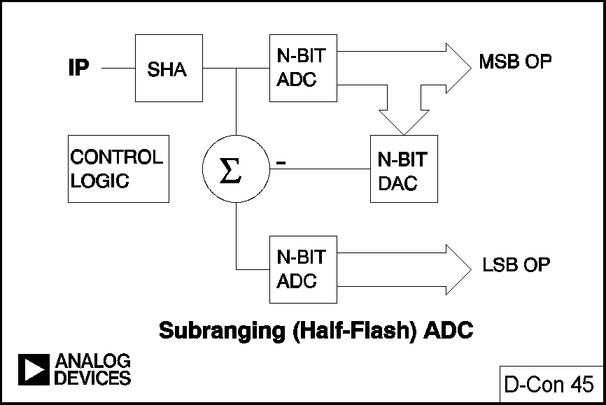
Subranging (Half-Flash) ADC
Notes:
Fig. 45 shows a basic subranging architecture (there are many possible variations, but the principle is the same). The analog signal is applied to an N-bit flash converter. The result of the conversion is applied to an N-bit DAC with >2N-bit accuracy. The analog output from the DAC is subtracted from the original signal and the remainder is amplified and applied to another N-bit flash ADC (or it could be switched to the same ADC that was used for the first conversion). The first conversion obtains the N msbs. The D-A conversion and subtraction removes the msb information from the analog signal, and the second A-D conversion provides the N lsbs.
Obviously such a proceedure is not as fast as a simple flash conversion, but it is much faster than a successive approximation routine (qv). Furthermore the complexity and power for a given resolution is much less than for a flash converter. Subranging converters can have resolutions up to 16-bits and conversion rates of 50 MSPS (although not both together at the time of writing - late 1992).
One of the limitations on the speed of a subranging converter is the settling time for the first A-D conversion and the D-A conversion. If these times could be reduced the conversion rate could be increased. If the final accuracy requirement of a DAC or flash ADC is reduced the settling time is also reduced - this forms the basis for the subranging ADC with digital error correction.

Slide 57
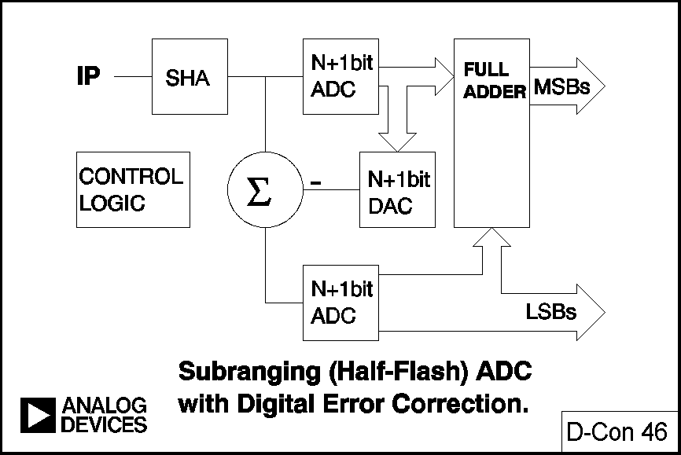
Subranging ADC with Digital Error Correction
Notes:
The basic architecture is unchanged, but the resolution of the two A-D conversions and the D-A conversion are increased by 1-bit. The first A-D conversion and the D-A conversion are performed more quickly and there is some loss of accuracy due to inadequate settling time. However, the second A-D conversion is higher resolution and contains enough data to correct the error in the msb conversion. The simplest way to do this is by use of a full adder. The increase in complexity is small and the increase in speed can be substantial.
So far we have considered only two-stage subranging ADCs, as these are easiest to analyse. There is no reason to stop at two stages, however. Indeed, a successive approximation ADC (qv) might be considered the limiting case of a multi-stage subranging ADC, although I do not propose to analyse it in this way. However three-pass and four-pass subranging ADCs are quite common, and can be made in many different ways, with or without digital error correction.

Slide 58
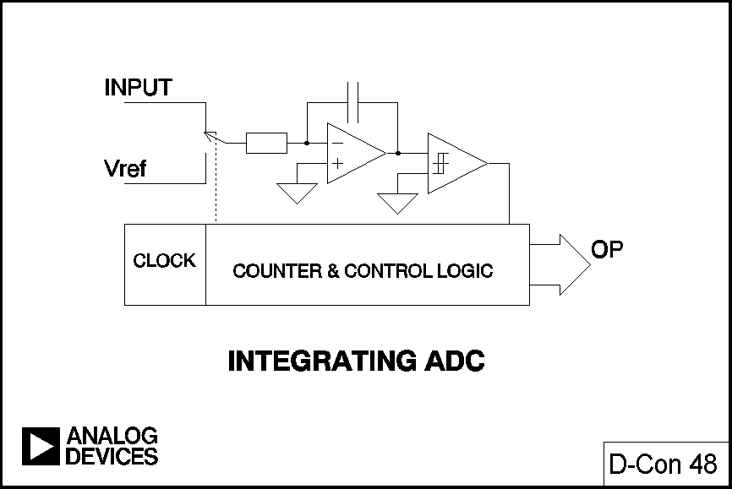
Integrating ADC
Notes:
The integrator is charged from the unknown voltage for a fixed time defined by the converter clock. It is then fully discharged connected to the reference voltage, and the discharge time measured by the same clock. The ratio of the input to the reference is the ratio of discharge to charge times. Since the integrator and the clock are the same during charge and discharge they do not contribute to errors, although offset and bias currents do. However these may be cancelled out by using four charge/discharge cycles instead of two and the resulting conversion is very accurate.

Slide 59
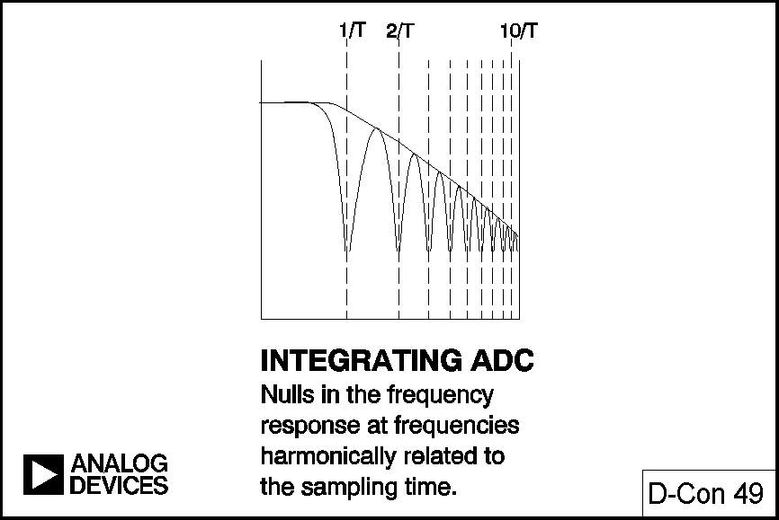
Integrating ADC
Notes:
Simple monolithic integrating ADCs using CMOS, which is not renowned for its analog amplifier or comparator performance, are quite capable of 16-bit accuracy. The technique is used in most DVMs (digital voltmeters) from portable 2½ digit ones operating for hundreds of hours from a pair of button cells, to 6½ digit transfer standards. Another advantage of the technique for DVM applications is that if the input changes during a measurement the result of the conversion is the mean value of the input over the conversion cycle. If a suitable conversion time is chosen 50 Hz or 60 Hz line ripple will essentially be ignored by an integrating ADC.

Slide 60
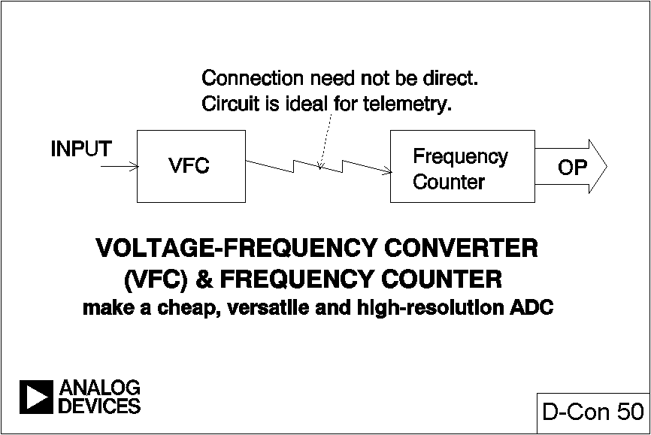
VFCs
Notes:
Another integrating ADC consists of a VFC (voltage to frequency converter) and a frequency counter.
A VFC is an oscillator whose frequency is linearly proportional to a control voltage. The VFC/counter ADC is monotonic and free of missing codes, integrates noise, and can consume very little power. It is also very useful for telemetry applications, since the VFC, which is small, cheap and low-powered can be mounted on the experimental subject (patient, wild animal, artillary shell, or w.h.y?) and communicate with the counter by a telemetry link.
There are two common VFC architectures (there are many more VFO [variable frequency oscillator] architectures, including the ubiquitous 555, but the key feature of VFCs is linearity - few VFOs are very linear): the current steering multivibrator and the charge-balance VFC. The charge-balanced VFC may be made in asynchronous or synchronous (clocked) forms.

Slide 61
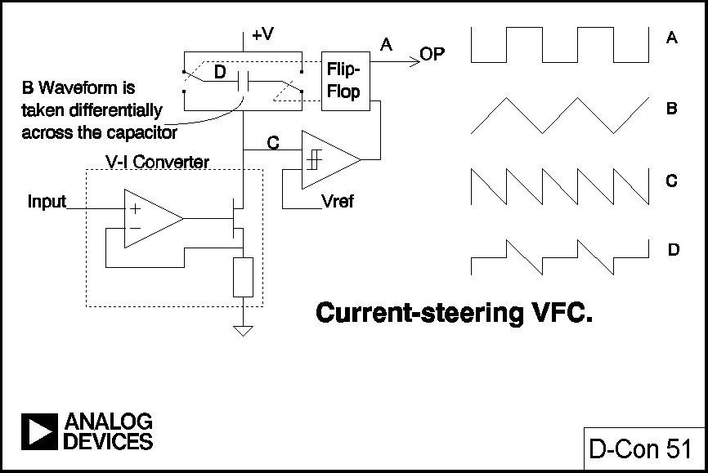
Current-Steering VFC
Notes:
The current steering multivibrator is actually a current-frequency converter rather than a VFC, but, as in the diagram, practical circuits invariably contain a voltage-current converter at the input. The principle of operation is evident: the current discharges the capacitor until a threshold is reached, when the capacitor terminals are reversed and the half-cycle repeats itself. The waveform across the capacitor is a linear tri-wave, but the waveform on either terminal w.r.t. ground is the more complex waveform shown.
Practical VFCs of this type have linearities around 14-bits, and comparable stability, although they may be used in ADCs with higher resolutions without missing codes. The performance limits are set by comparator threshold noise and threshold TC, and the stability and dielectric absorbtion (DA) of the capacitor, which is generally a discrete component. The comparator/voltage reference structure shown in the diagram is more of a representation of the function performed than the actual circuit used, which is much more integrated with the switching and correspondingly harder to analyse.
This type of VFC is simple, inexpensive and low-powered, and most run from a wide range of supply voltages. They are ideally suited for low cost medium accuracy ADC and data telemetry applications.

Slide 62
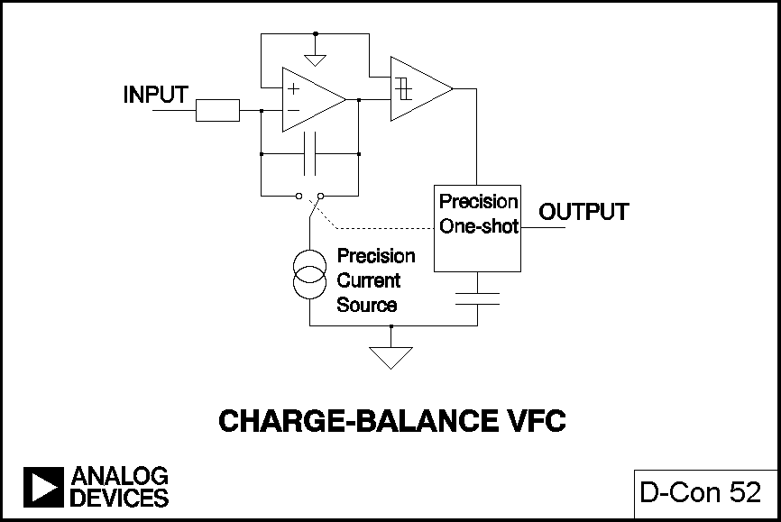
Charge-Balance VFC
Notes:
The charge balance VFC is more complex, more demanding in its supply voltage and current requirements, and more accurate. It is capable of 16-18 bit linearity.
The integrator capacitor charges from the signal. When it passes the comparator threshold a fixed charge is removed from the capacitor, but the input current continues to flow during the discharge so no input charge is lost. The fixed charge is defined by the precision current source and the pulse width of the precision monostable. The output pulse rate is thus accurately proportional to the rate at which the integrator charges from the input.
At low frequencies the limits on the performance of this VFC are set by the stability of the current source and the monostable timing (which depends on the monostable capacitor, among other things). The absolute value and temperature stability of the integration capacitor do not affect the accuracy, although its leakage and DA do. At high frequencies second-order effects, such as switching transients in the integrator and the precision of the monostable when it is retriggered very soon after the end of a pulse, take their toll on accuracy and linearity.
The changeover switch in the current source addresses the integrator transient problem. By using a changeover switch instead of the on/off switch commoner on older VFC designs (a) there are no on/off transients in the precision current source and (b) the output stage of the integrator sees a constant load - most of the time the current from the source flows directly in the output stage, during charge balance it still flows in the output stage but through the integration capacitor.
The stability and transient behaviour of the precision monostable are more intransigent problems, but the issue may be avoided by replacing the monostable with a clocked bistable multivibrator. This arrangement is known as a synchronous VFC or SVFC.

Slide 63
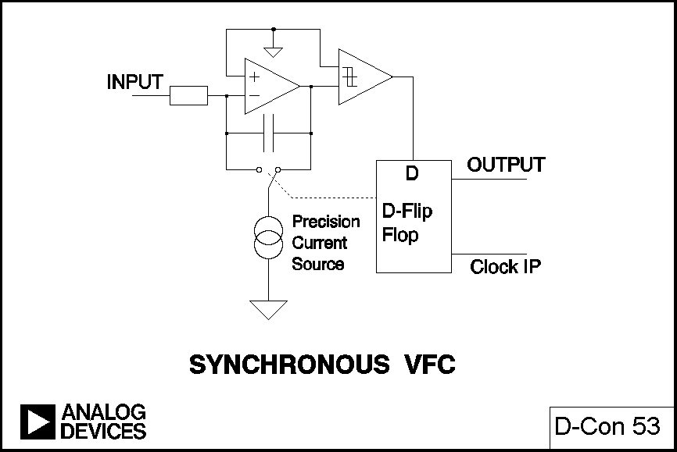
Synchronous VFC
Notes:
The difference from the previous circuit is quite small, but the charge balance pulse length is now defined by two successive edges of the external clock. If this clock has low jitter the charge will be very accurately defined. The output pulse will also be synchronous with the clock. SVFCs of this type are capable of up to 18-bit linearity and excellent temperature stability.

Slide 64
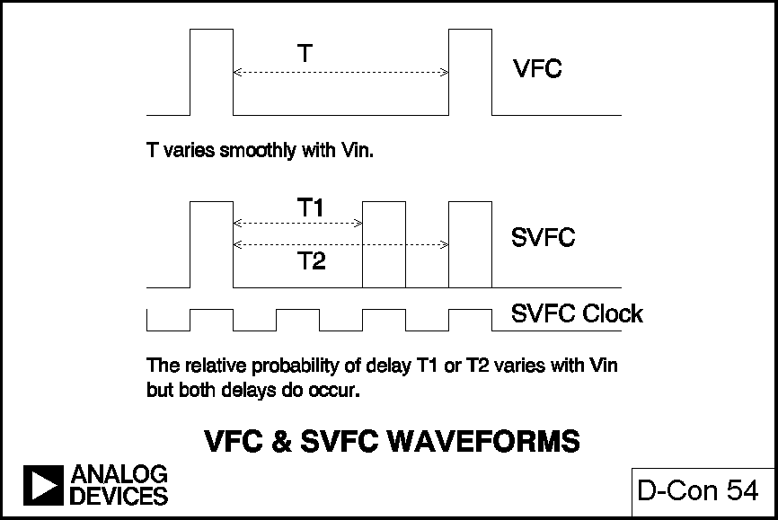
VFC & SVFC Waveforms
Notes:
This synchronous behaviour is convenient in many applications, since synchronous data transfer is often easier to handle than asynchronous, but it does mean that the output of an SVFC is not a pure tone (plus harmonics, of course) like a conventional VFC, but contains components harmonically related to the clock frequency. The display of an SVFC output on an oscilloscope is especially misleading, and a common cause of enquiries to the Applications Department: a change of input to a VFC produces a smooth change of output frequency, but a change to an SVFC produces a change in probability density of output pulses N and N+1 clock cycles after the previous output pulse, which is often perceived by inexperienced users as severe jitter and a sign of a faulty device.

Slide 65
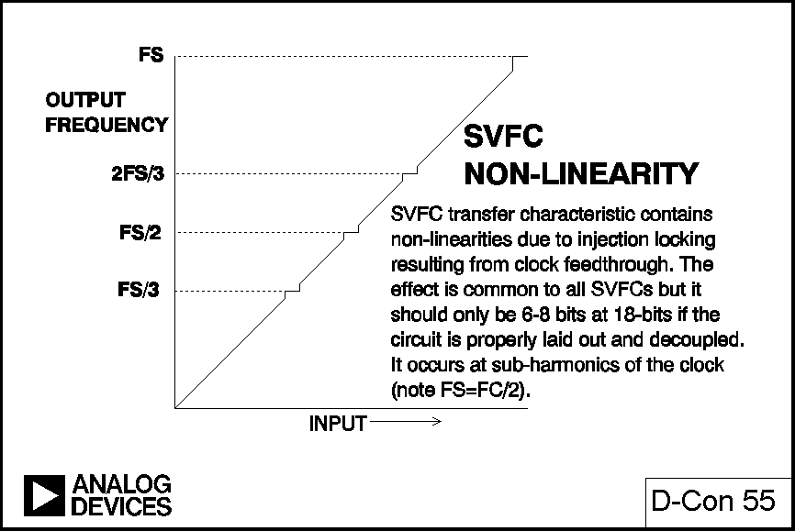
SVFC Non-Linearity
Notes:
Another problem with SVFCs is non-linearity at output frequencies related to the clock frequency. If we study the transfer characteristic of an SVFC we find non-linearities close to sub-harmonics of the clock frequency F_{C}, especially at F_{C}/3, F_{C}/4, and F_{C}/6. This is due to stray capacitance on the chip (and in the circuit layout!) coupling the clock signal into the SVFC comparator and causing the device to behave as an injecton-locked phase-locked loop (PLL). This problem is intrinsic to SVFCs, but is not often serious: if the circuit card is well laid out, and clock amplitude and dV/dT kept as low as practicable the effect is a discontinuity in the transfer characteristic of less than 8-bits (at 18-bit resolution) at F_{C}/3 and F_{C}/4, and less at other sub-harmonics. This is frequently tolerable, since the frequencies where it occurs are known. Of course if the circuit layout or decoupling is poor the effect may be much larger, but this is the fault of poor design and not the SVFC itself.
It is evident that the SVFC is quantised, while the basic VFC is not. It does NOT follow from this that the counter/VFC ADC has higher resolution (neglecting non-linearities) than the counter/SVFC ADC because the clock in the counter also sets a limit to the resolution.

Slide 66
VFCs
It is possible to use the PERIOD of a VFC, rather than its frequency, to measure its input
VFCs have other applications than as ADC elements: these include isolation and use as FVCs
Notes:
When a VFC has a large input it runs quickly and counting for a short time gives good resolution, but it is hard to get good resolution in a reasonable sample time with a slow-running VFC. In such a case it may be more practical to measure the period of the VFC output (this does not work for an SVFC), but of course the resolution of this system deteriorates as the input (and the frequency) increases. However, if the counter/timer arrangement is made smart it is possible to measure the approximate VFC frequency and the exact period of not one but N cycles, where the value of N is determined by the approximate frequency, and maintain high resolution over a wide range of inputs. The AD1170 is an example of this architecture.
VFCs have more applications than as a component in ADCs. Since their output is a pulse stream it may easily be sent over a wide range of transmission media (PSN, radio, optical, IR, ultra-sonic, etc.). It need not be received by a counter, but by another VFC configured as a frequency-voltage converter (FVC). This gives an analog output, and a VFC-FVC combination is a very useful way of sending a precision analog signal across an isolation barrier. There are a number of issues to be considered in building FVCs from VFCs (especially where the VFCs are SVFCs, which introduces some nasty pitfalls) and these are considered in reference [5].

Slide 67
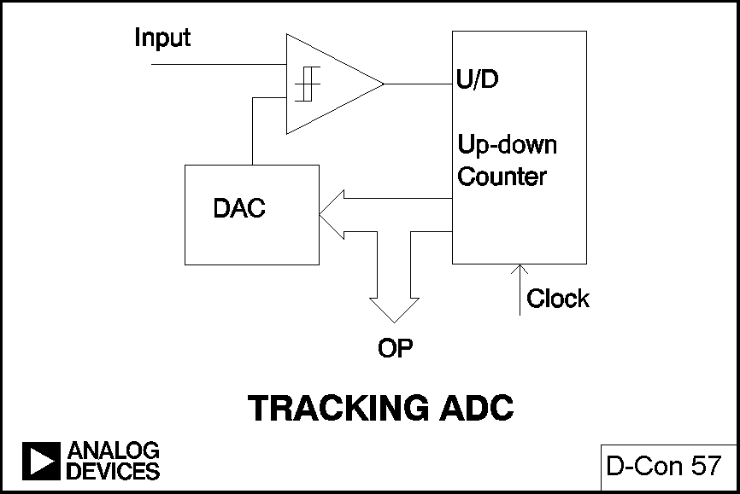
Tracking ADCs
Notes:
Having considered two types of fast ADC and two types of slow ADC it is interesting to consider a type which is both fast and slow. The tracking ADC consists of a comparator, a DAC and an up/down counter.
The analog input is applied to one input of the comparator, and the DAC output to the other. The DAC input is driven by the counter. If the analog input exceeds the DAC output the counter counts up until they are equal, if the DAC output exceeds the analog input the counter counts down until they are equal. It is evident that if the analog input changes slowly the counter will follow and the digital output will remain close to its correct value, whereas if the analog input suddenly undergoes a large step change it will be many hundreds or thousands of clock cycles before the output is again valid - hence the statement that such an ADC is both fast and slow: it responds quickly to a slowly changing signal but slowly to a quickly changing one.
The simple analysis above ignores the behaviour of the ADC when the analog input and DAC output are nearly equal. This will depend on the exact nature of the comparator and counter. If the comparator is a simple one the DAC output will cycle by 1 lsb from just above the analog input to just below it, and the digital output will, of course, do the same: there will be 1 lsb of flicker.. Note that the output in such a case steps every clock cycle irrespective of the exact value of analog input and hence always has unity M-S ratio (in other words there is no possibility of taking a mean value of the digital output and increasing resolution by oversampling).
A more satisfactory, but more complex, arrangement would be to use a window comparator with a window 1-2 lsb wide. When the DAC output is high or low the system behaves as in the previous description, but if the DAC output is within the window the counter stops. This arrangement eliminates the flicker, provided that the DAC DNL never allows the DAC output to step across the window for 1 lsb change of code.
Tracking ADCs are not very common. Their slow step response makes them unsuitable for many applications and they have few compensating advantages. But they do have one asset: their output is continuously available. Most ADCs perform conversions: i.e. on receipt of a "start convert" command (which may be internally generated) they perform a conversion and, after a delay, a result becomes available. Always providing that the analog input changes slowly the output of a tracking ADC is always available. This is valuable in synchro to digital and resolver to digital converters (SDCs and RDCs) and this is the application where tracking ADCs are most often used. A very small change in their architecture, however, produces one of the most widespread ADC designs, the successive approximation ADC.

Slide 68
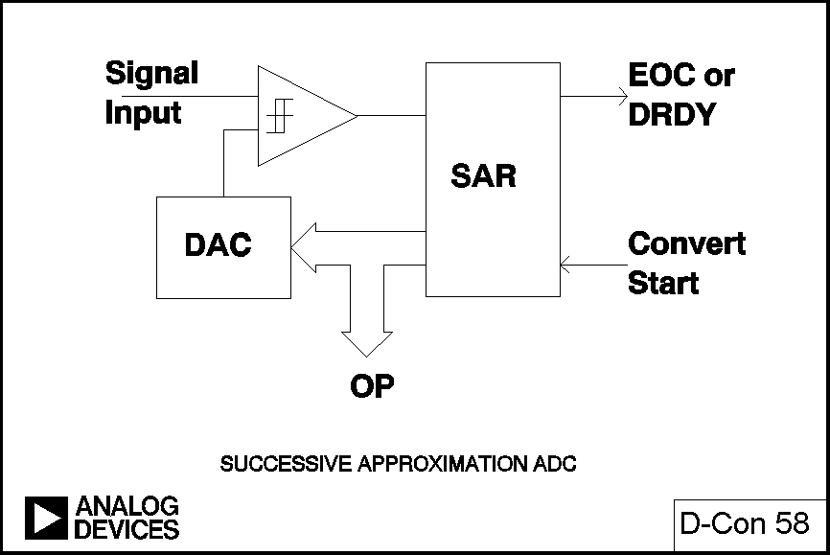
Successive Approximation ADCs
Notes:
In a successive approximation ADC the counter of the tracking ADC is replaced by a successive approximation register (SAR). The successive approximation ADC performs conversions on command. On the START CONVERT command all the bits of the SAR are reset to 0 except the msb which is set to 1. If the DAC output is greater than the analog input this bit is reset, otherwise it is left set. The next most significant bit is then set to 1. If the DAC output is greater than the analog input this bit is reset, otherwise it is left set. The process is repeated with each bit in turn. When all the bits have been set, tested, and reset or not as appropriate, the contents of the SAR correspond to the value of the analog input and the conversion is complete.
An N-bit conversion takes N steps. It would seem on superficial examination that a 16-bit converter would have half the conversion rate of an 8-bit one, but this is not the case. In an 8-bit converter the DAC must settle to 8-bit accuracy before the bit decision is made, whereas in a 16-bit converter it must settle to 16-bit accuracy, which takes a lot longer. In practice 8-bit successive approximation ADCs can convert in a few hundred nS, while 16-bit ones will generally take several µS.
The successive approximation ADC has a very simple structure, low power, and reasonably fast conversion times. It is probably the most widely used ADC architecture, and will continue to be used for medium speed and medium resolution applications. As levels of analog integration increase, however, the subranging ADC will be increasingly used for high speed medium resolution applications, and the rise of cheap digital signal processing (DSP) makes the Σ−Δ architecture increasingly attractive for low bandwidths and very high resolutions.

Slide 69
Successive Approximation ADCs
In modern successive approximation, ADCs the DAC is frequently constructed from capacitors (this is called a charge redistribution DAC).
The architecture is smaller, cheaper, faster and easier to manufacture than traditional resistive DACs but capacitor leakage may (not always) necessitate a minimum clock rate
Notes:
The successive approximation ADC has a very simple structure, low power, and reasonably fast conversion times. Recently the DAC structure in this type of converter has changed – resistor networks being replaced by charge distributing capacitive DACs. These are smaller and cheaper, and can be made on fast, low cost, high density processes, and the resulting ADCs are, accordingly, faster, cheaper, and smaller than their predecessors.

Slide 70
Σ−Δ
Sigma-Delta ADCs have a very high resolution, and they’re very cheap.
But the theory of the operation is hard.
Their bandwidth is not marvellous either.
Notes:
But Σ−Δ theory is complex and its mode of operation often misunderstood.

Slide 71
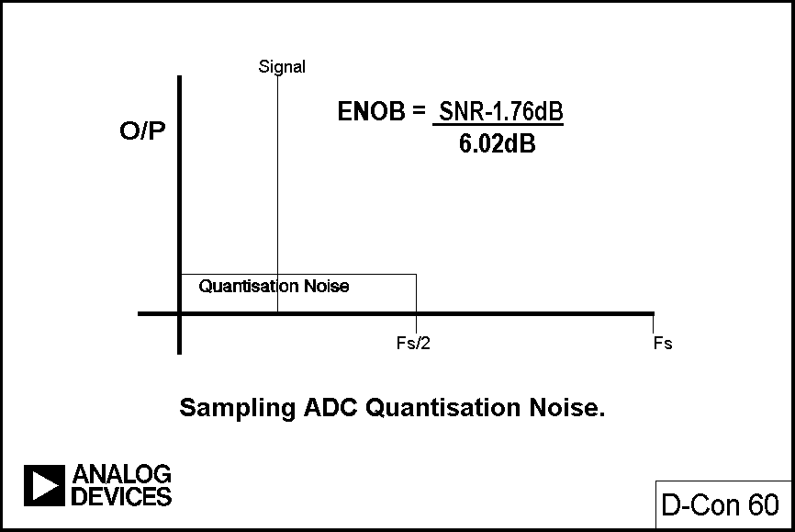
Sampling ADC Quantization Noise
Notes:
Consider a perfect classical N-bit sampling ADC. It has an r.m.s. quantisation noise of q/ in the Nyquist band of DC - f_{s}/2 (where q is the value of an lsb) and therefore the SNR with a full-scale sinewave input will be (6.02N + 1.76) dB. If the ADC is less than perfect and its noise is greater than its theoretical minimum quantisation noise, then its effective resolution will be less than N-bits. Its actual resolution (ENOB) will be defined by

Slide 72
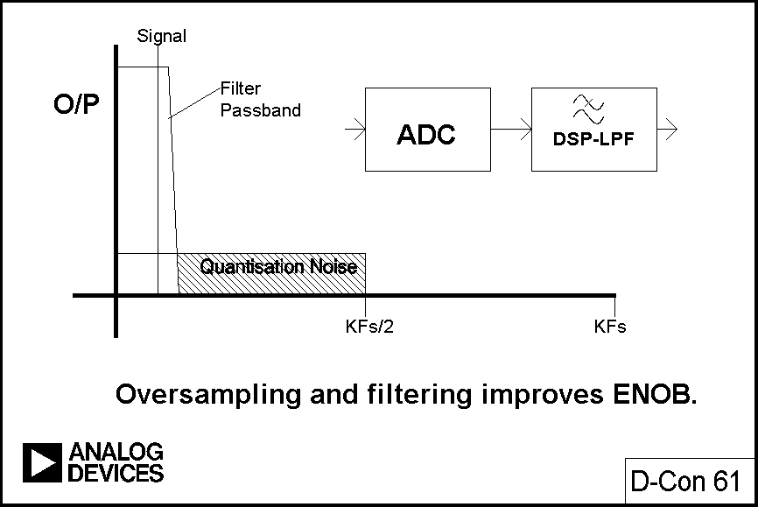
Oversampling and Filtering Improves ENOB
Notes:
If we choose a higher sampling rate the quantisation noise is distributed over a wider bandwidth and if we then apply a digital low pass filter (LPF) to the output we remove much of the quantisation noise but do not affect the signal - so the ENOB is improved. This is the principle of "over-sampling", which allows us to increase the resolution of an ADC. (Since the bandwidth is reduced by the output filter the output data rate may be lower than the sampling rate - this may be achieved by passing every Mth result to the output and discarding the remainder. The process is known as "decimation" by a factor of M. Despite the origins of the term [decem is Latin for ten], M can have any integral value. Decimation results in no loss of information, provided only that the output data rate is more than twice the signal bandwidth.)
If we simply use over-sampling to improve resolution we must over-sample by a factor of 2^{N} to increase the resolution of the system by N bits. The Σ−Δ converter does more than this - it limits the signal passband and shapes the quantisation noise so that it falls outside this passband. This reduces the over-sampling factor necessary to achieve a given increase in resolution.

Slide 73
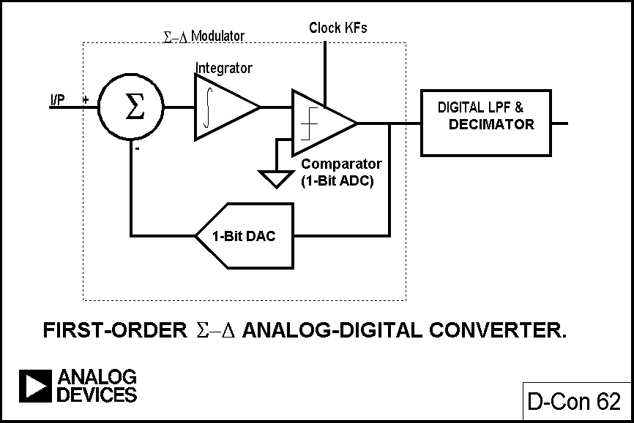
First-Order ΣΔ ADC
Notes:
If we take a comparator, drive it with the output of an integrator, and feed the integrator with an input signal summed with the output of a 1-bit DAC fed from the ADC output, we have a first-order Σ−Δ modulator. Add a digital low pass filter (LPF) and decimator at the digital output and we have a Σ−Δ ADC: the Σ−Δ modulator shapes the quantisation noise so that it lies above the passband of the output filter, and the ENOB is therefore much larger than would otherwise be expected from the over-sampling ratio.

Slide 74
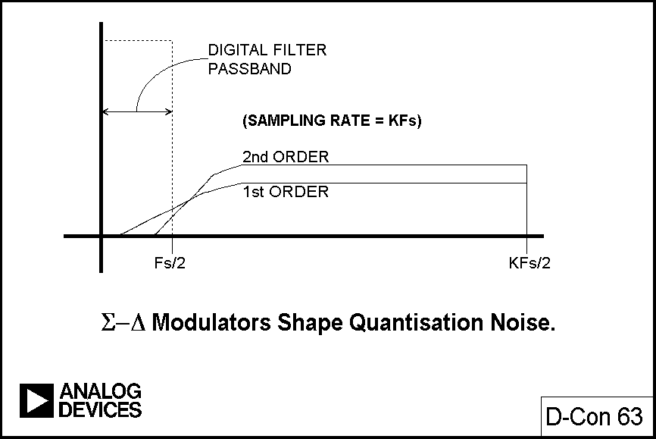
ΣΔ Modulators Shape Quantization Noise
Notes:
By using more than one integration and summing stage in the Σ−Δ modulator we can achieve higher orders of quantisation noise shaping and an even better ENOB for a given over-sampling ratio. Third, and higher, order Σ−Δ ADCs were once thought be potentially unstable at some values of input - recent analyses using finite rather than infinite gains in the comparator have shown that this is not necessarily so, but even if instability does start to occur it is not important, since the DSP in the digital filter and decimator can also be used to recognise incipient instability, and react to prevent it. The additional software and hardware necessary for this turns out to be very simple.

Slide 75

Second-Order ΣΔ ADC
Notes:
The Σ−Δ ADCs that we have described so far contain integrators, which are low pass filters. They therefore have a passband extending from DC, and quantisation noise is pushed up in frequency. At present all commercially available Σ−Δ ADCs are of this type (although some which are intended for use in audio or telecommunications applications contain bandpass digital filters to eliminate any DC response). Σ−Δ ADCs are available with resolutions up to 24-bits for DC measurement applications (AD7710) and with resolutions of 18-bits for high quality digital audio applications (AD1879).

Slide 76

Bandpass ΣΔ ADCs
Notes:
But there is no particular reason why the filters of the Σ−Δ modulator should be LPFs, except that traditionally ADCs have been thought of as being baseband devices, and that integrators are somewhat easier to construct than bandpass filters. If we replace the integrators in a Σ−Δ ADC with bandpass filters (BPFs) the quantisation noise is moved up and down in frequency to leave a virtually noise-free region in the pass-band. If the digital filter is then programmed to have its pass-band in this region we have a Σ−Δ ADC with a bandpass, rather than a low pass characteristic. The centre frequency may be as high as several MHz.
There are few commercially available bandpass Σ−Δ ADCs at present, but they have been built in the laboratory and are beginning to be introduced for specialised applications. (Reference [6].)
Just as there is nothing in the theory of Σ−Δ ADCs to prevent bandpass operation, there is also no reason why the one-bit ADC (comparator) and one-bit DAC (switch) should not be replaced with higher resolution parts. This increases the complexity of the ADC, but reduces the amount of oversampling still further – and so increases speed. Baseband,, audio and faster Σ−Δ ADCs are beginning to be designed with multibit internal converters, but of course such devices are not intrinsically linear as one-bit parts are, so much more care has to be taken to ensure that such devices do have adequate linearity.

Slide 77

Sample-Hold Amplifiers (SHAs)
Notes:
SAMPLE AND HOLD AMPLIFIERS (SHAs)
If successive approximation and subranging ADCs are to work correctly the analog input must remain constant to within ±½ lsb during conversion. If we calculate the constraints that this imposes on the maximum input frequency it is alarming: the maximum full-scale sinusoidal input frequency to a 10 µS/16-bit ADC is 0.24 Hz - less than one cycle every four seconds. The Nyquist frequency of such a converter, however, is 50 KHz.
To overcome the problem (and also to improve the ENOB of some flash ADCs) all that is necessary is to incorporate a SHA in the system. A SHA is a circuit which latches an analog signal in the state that it was at the moment a "sample" command was received. Sample and hold circuits are often referred to as "track and hold" circuits (THAs). For most purposes the two terms are interchangeable, though there is a difference: the output of a SHA does not need to track the analog input at any time, although many do, whereas a THA must track as well as hold. For ADC input applications the track function is not necessary, but there are other places where it is. SHAs are discussed in detail in references [1] and [7] and it is not necessary to analyse them here.
What is necessary is to appreciate that discrete SHA circuits are not necessary with most modern ADCs, since if a SHA is required it will be integrated in the ADC chip. This is far better than using a separate SHA, since the parameters of the SHA will be tailored to the needs of the ADC, and the whole system will be specified, rather than having separate SHA and ADC specifications which must be married together.
In general sampling ADCs with integrated SHAs should be used wherever the system design requires the use of a SHA. The only exception is with flash ADCs, since most flash ADCs are built with processes that are incapable of making a good SHA.

Slide 78
MicroConverterTM Definition
High Performance Analog I/O
+
FLASH Memory
+
Microcontroller
=
1
2
3
MicroConverterTM

Slide 79
Introducing the ADuC812
12bit,8ch ADC & dual 12bit DAC
+
8Kbyte Program & 640byte Data FLASH
+
Industry Standard 8052
=
1
2
3
ADuC812

Slide 80
ADuC812 - Analog I/O
1
8channel, 12bit, 5µs, Autocalibrating ADC
  DMA Controller for High Speed Capture
  True 12bit Performance (INL, SNR, etc.)
Two 12bit, 4µs, Voltage Output DACs
  Guaranteed 12bit Monotonicity
On-Chip 2.5V Precision Bandgap Reference
On-Chip Temperature Sensor
Simple ADC & DAC Control Through Software or Hardware

Slide 81
ADuC812 - Flash Memory
2
RETAIN DATA WITHOUT POWER!
8Kbytes Nonvolatile Program Memory
  Stores Program and Fixed Lookup Tables
  In-Circuit Serial Programmable or External Parallel Programmable
640bytes Nonvolatile Data Memory
  User “Scratch Pad” for Storing Data During Program Execution
  Simple Read/Write Access Through SFR Space
Built-In Security Features for Both Program & Data FLASH
Programming Voltage (V_{PP}) Generated On-Chip

Slide 82
ADuC812 - Microcontroller
3
Industry Standard 8052 Core
  12 Clock Machine Cycle w/ up to 16MHz Clock
  32 Digital I/O Pins
  Three 16bit Counter/Timers
  UART Serial Port
...Plus Some Useful Extras
  SPI or I2C Compatible Serial Interface
  WatchDog Timer
  Power Supply Monitor

Slide 83
References
[1] "HIGH SPEED SEMINAR" ANALOG DEVICES INC. 1990 $20
[2] "MIXED SIGNAL SEMINAR" ANALOG DEVICES INC. 1991 $20
[3] "1992 AMPLIFIER APPLICATIONS GUIDE" ANALOG DEVICES INC. 1992 $20
[4] "DATA CONVERTER REFERENCE MANUAL (VOL II)" ANALOG DEVICES INC. (FREE)
[5] APPLICATION NOTE: "FREQUENCY-VOLTAGE CONVERTERS" BY JAMES M. BRYANT (IN PREPARATION)
ANALOG DEVICES INC. (FREE WHEN AVAILABLE - TYPESCRIPT ALREADY AVAILABLE FROM JAMES BRYANT)
[6] "A 4TH-ORDER BANDPASS SIGMA-DELTA MODULATOR" S.A.JANTZI, M.SNELGROVE & P.F.FERGUSON JR.
PROCEEDINGS OF THE IEEE 1992 CUSTOM INTEGRATED CIRCUITS CONFERENCE. PP 16.5.1-4
[7] "ANALOG-DIGITAL CONVERSION HANDBOOK" DANIEL H. SHEINGOLD (ED.) PRENTICE-HALL, 3RD EDITION. 1986

