Slide 1
ADSP-21369 Package Change PCN# 17_0163
August 2017

Slide 2
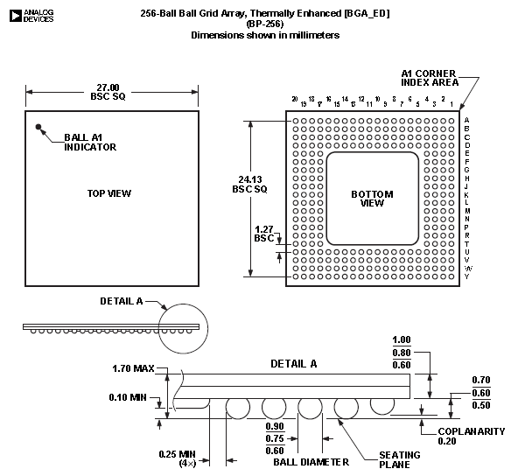
Current Package Drawing (SBGA)

Slide 3
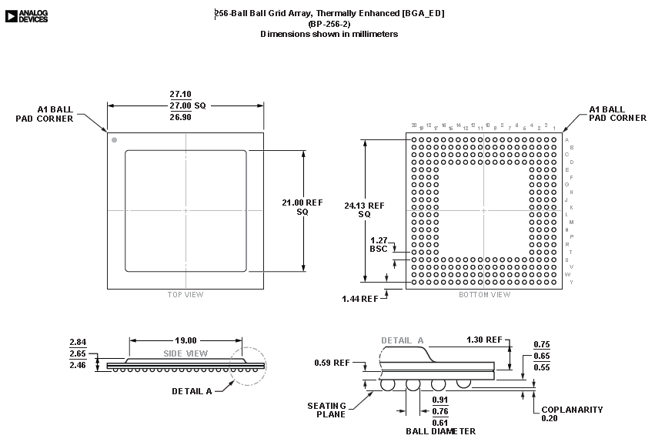
New Package Drawing (Flip-Chip BGA)

Slide 4
Significant Differences
Package thickness:
Current Pkg.: 1.70mm max.
New Package: 2.84mm max.

